Slide 1
European Master of Science in Occupational Therapy
Notes:
Welcome: CG

Slide 2
What is so special about it?
  It is truly international and unique…
Notes:
DKR slides 6 and 7
DKR: It is a truly international programme. You receive high quality education, in five different countries in Europe, with faculty from all these countries – which gives you access to an international network of OT‘s and OT researchers. And still, you can study from home…
You study with students from usually at least 6 different countries in small classes of about 25-30 students. There is a lot of group work which makes it possible to learn a lot about OT in different countries – you learn from and with each other.
Truly international:
Management shared among two universities in two countries
Staff from five universities / countries
Students: each cohort min. 6 countries
For all this, the programme received the Certificate for Quality in Internationalisation from the European Consortium for Accreditation in 2016
At end: short «interview» with Kinga: you are now part of an international cohort and you have met for the first time in Eastbourne beginning of September: how do you experience this international “spirit”? What helped you to get into it?

Slide 3
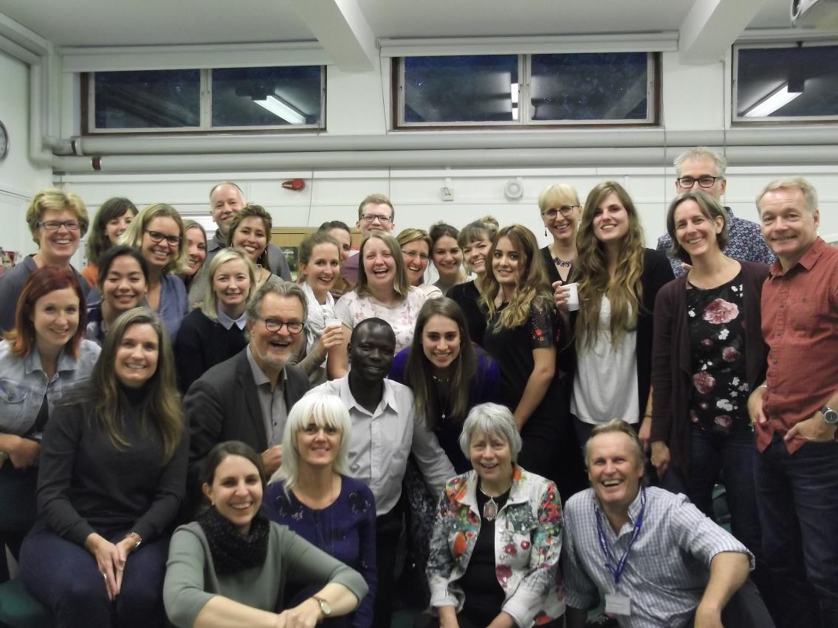
Notes:
DKR slides 6 and 7
DKR: It is a truly international programme. You receive high quality education, in five different countries in Europe, with faculty from all these countries – which gives you access to an international network of OT‘s and OT researchers. And still, you can study from home…
You study with students from usually at least 6 different countries in small classes of about 25-30 students. There is a lot of group work which makes it possible to learn a lot about OT in different countries – you learn from and with each other.
Truly international:
Management shared among two universities in two countries
Staff from five universities / countries
Students: each cohort min. 6 countries
For all this, the programme received the Certificate for Quality in Internationalisation from the European Consortium for Accreditation in 2016
At end: short «interview» with Kinga: you are now part of an international cohort and you have met for the first time in Eastbourne beginning of September: how do you experience this international “spirit”? What helped you to get into it?

Slide 4
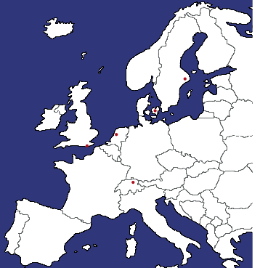
A “Carousel design”
  6 Karolinska Institutet
  Stockholm, SE
  2 Amsterdam University of
  Applied Sciences
  Amsterdam, NL
  1 University of Brighton
  Eastbourne, UK
  3 ZHAW Zürcher Hochschule für Angewandte Wissenschaften
  Winterthur, CH
  4 University of A Coruña
  A Coruña, Spain
Notes:
CG: What do we mean saying that you would study in five universities but still from home?
It is a part time programme over 2 years
The programme will bring you to five exciting places: Eastbourne, Amsterdam, Winterthur, A Coruna and Stockholm.
But since it is a part time programme, you keep your working place and you travel to these places for usually two intensive weeks. Before and after you work on the topics from home.

Slide 5
A “Carousel design”
  6 modules, 5 at different universities
  2 years part time
  90 credits ECTS
    Modules 1-4:
    Preparatory work (2 weeks)
    Class work (2 weeks)
    Assignment (8 weeks)
    Module 5 and 6: Thesis modules
Notes:
CG: All in english: from the information to the application to all lectures, all assignments, the MSc thesis
«Carousel design»: 6 modules, 5 at different universities – all modules are mandatory
Part time, 2 years, 90 credits (ECTS)
At end, short interview with Miranda and Siki: you have now started module 5, which focuses on the thesis project; what will your thesis be about? how are you experiencing the change between class work together with the other students and the long self study time now in module 5? What keeps you motivated?

Slide 6
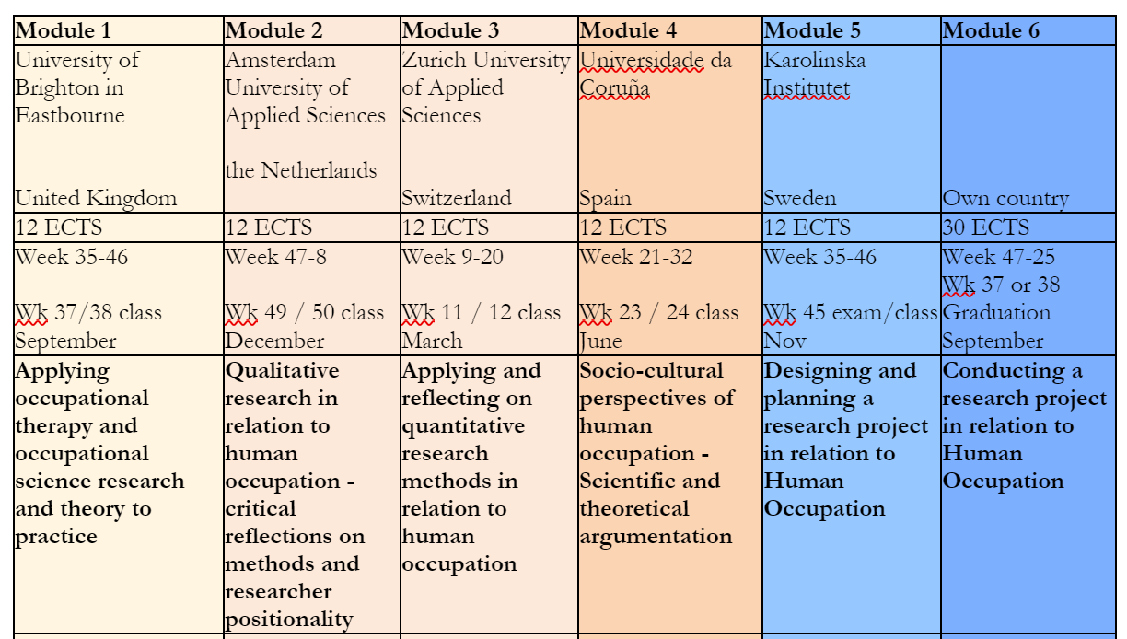
The six modules
Notes:
DKR: shortly introduce the content of the 6 modules
Each module is hosted by a team at one of the partner universities and has a module coordinator
At end: short interview with Heidi: Heidi, in module 1 one important goal is to introduce the students to the programme and to make sure the students create a kind of group or team spirit. How do you do that during module 1? What are you passionate about in the EuroMaster?

Slide 7
Competences
  Focus on
  Scientific competencies and research skills
  International perspectives on Occupational Science and Occupational Therapy
    evaluate, account for and innovate current practice
    «generalistic education» – applicable in all fields
Notes:
CG: summarize the competences you achieve with this programme
At end: Interview with Vicky: you are an aluma of the EuroMaster, you went through all this and you graduated in August 2020. Is it true what this slide says? Did you achieve these competences through the EuroMaster? Did studying in this programme have an impact on your professional development? If yes in which way? Do you have further plans?

Slide 8

Admission criteria
BSc in Occupational Therapy
English language skills on academic level (f.ex. academic IELTS, Score 6.5)
Notes:
CG

Slide 9

Admission and costs
Deadline for admissions
May 1st
Start week 35
Costs (EU citizens)
€2,209 Euro for year 22/23*
Travel and accomodation
*subject to yearly adaptation
Notes:
CG

Slide 10
More Information
www.ot-euromaster.nl
ot-euromaster@hva.nl

