Slide 1
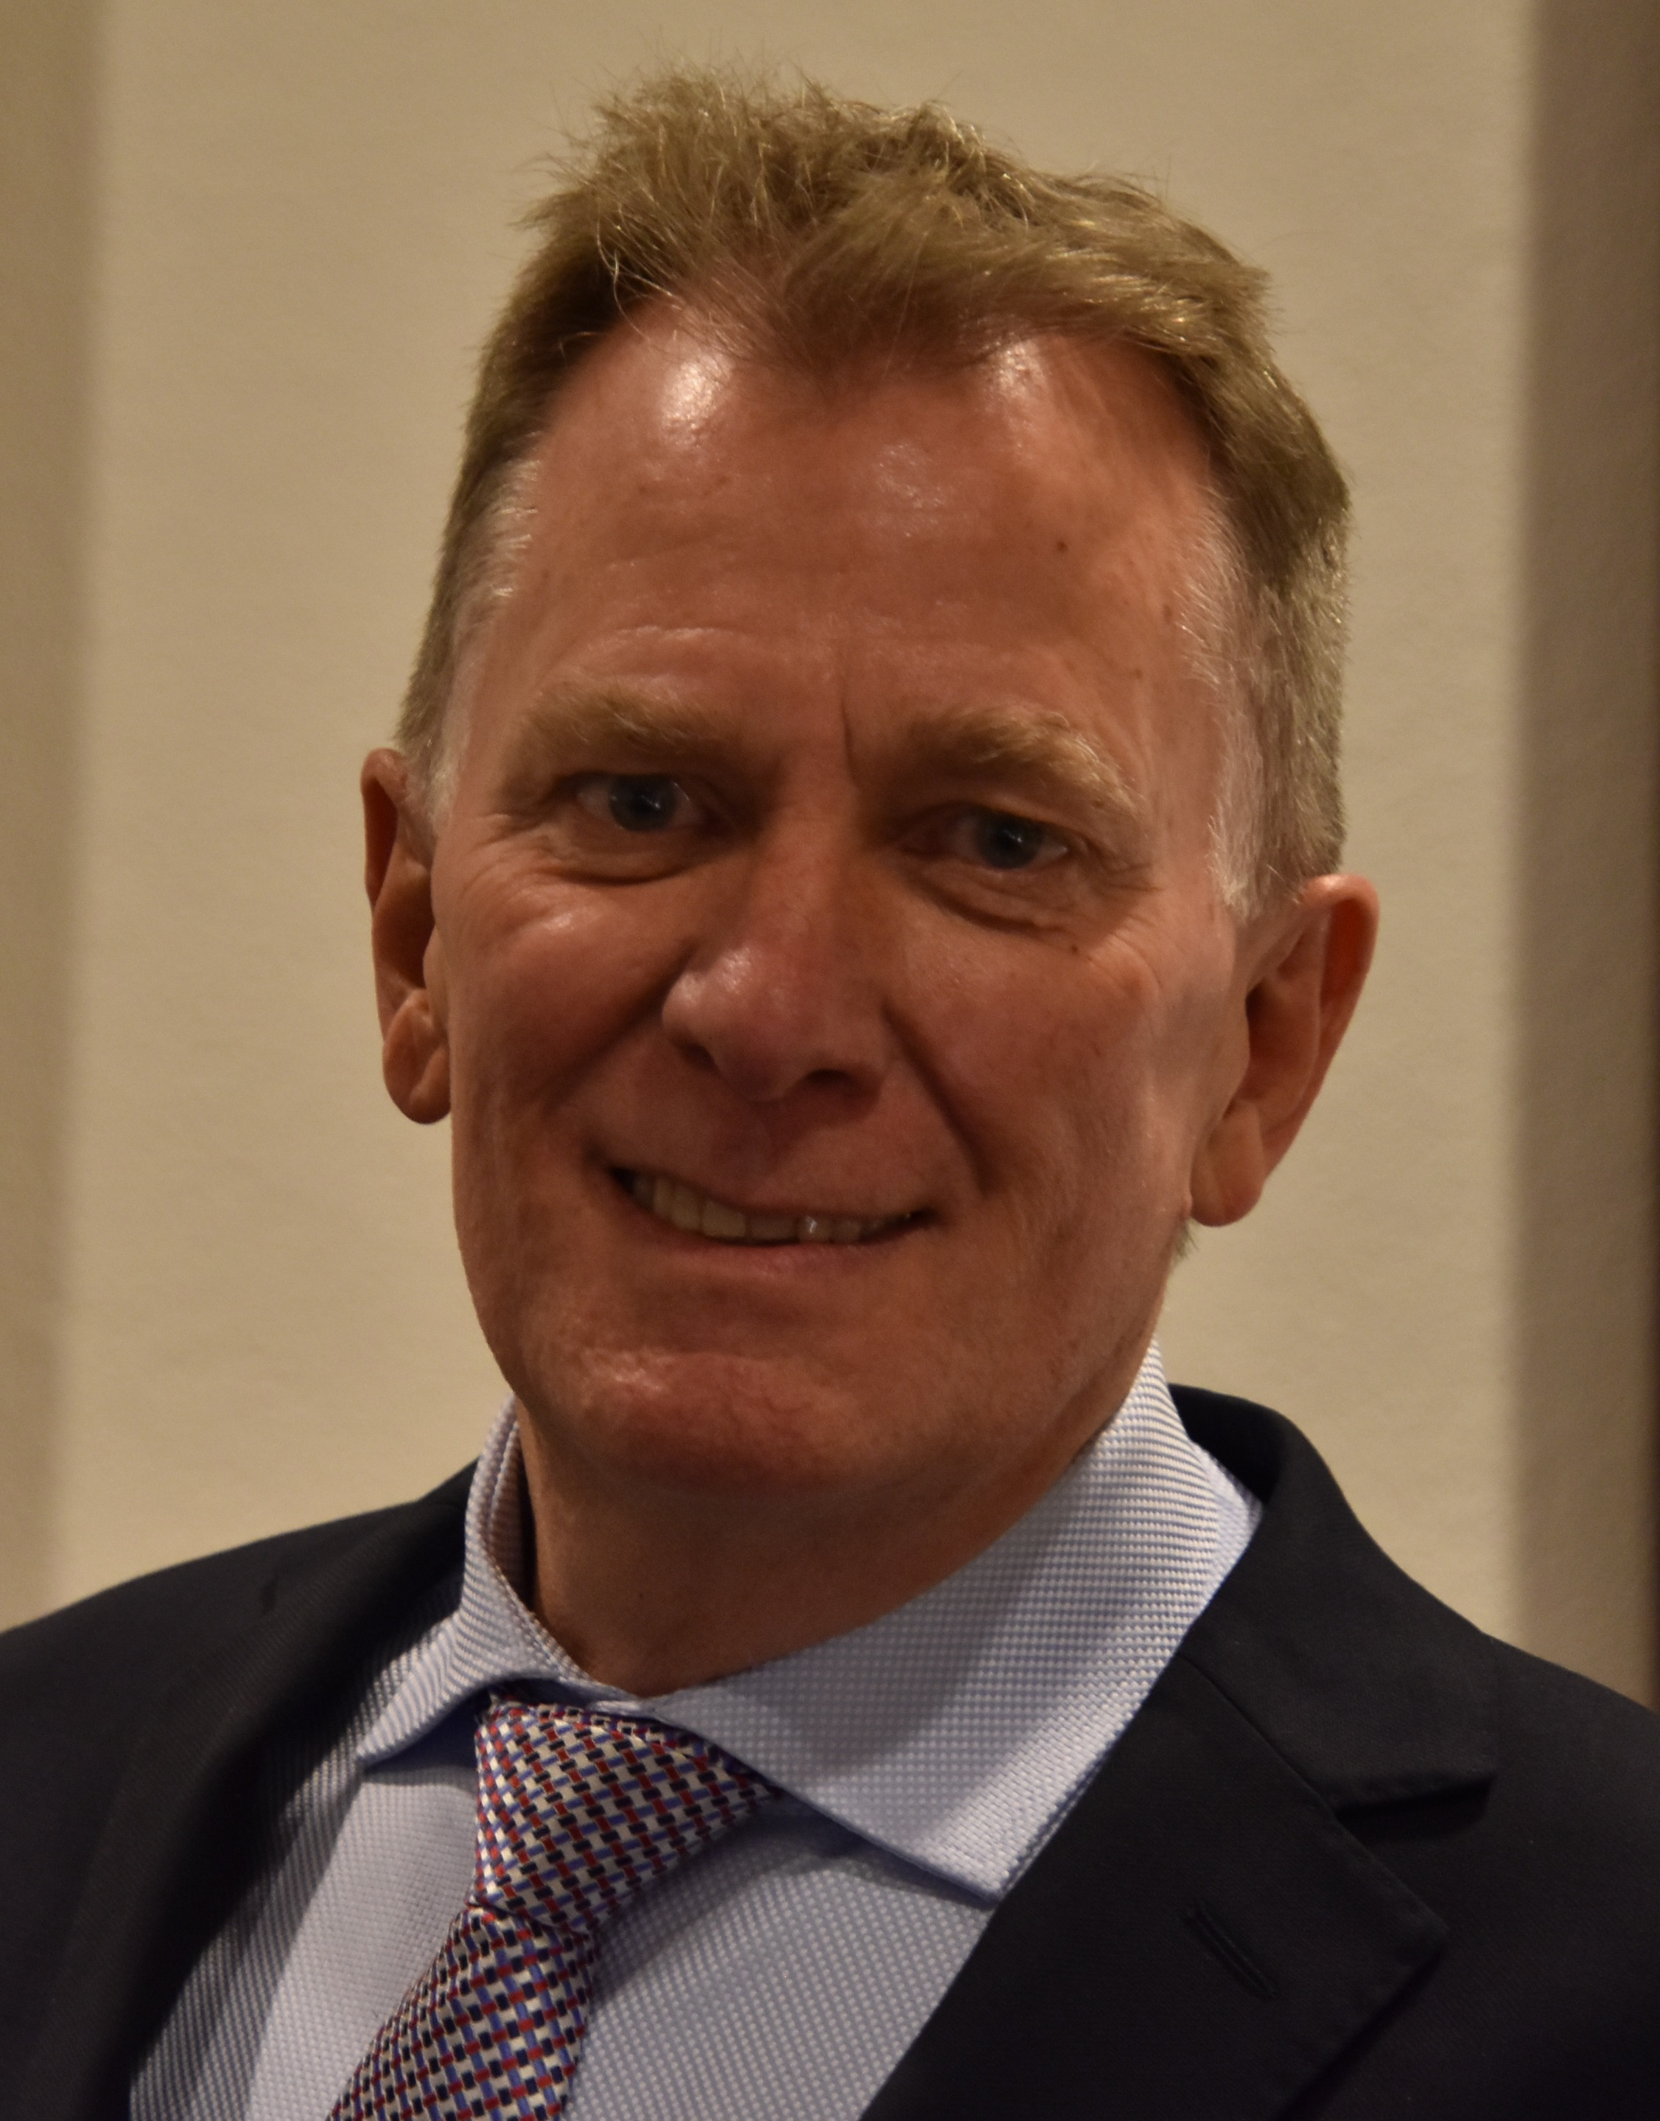
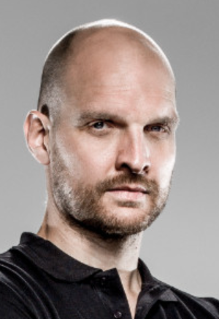
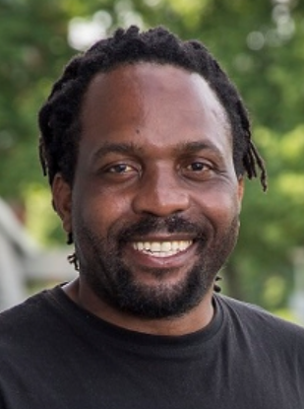
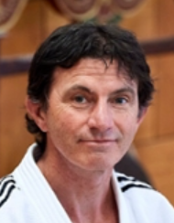
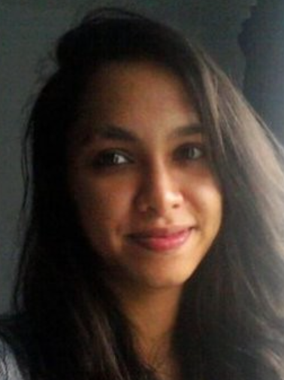
ExamINATION BOARD
Jan Luitzen, Dr: voorzitter
Peter van Paassen, MA: member
Pachena Madokwenyu, MA: member
Thijs Mensink, BEd: external member (ALO)
Gaby Duttenhofer, BA: clerk

Slide 2
Agenda info Session
What the examination committee (EC) does
Teaching- and Examination Regulations (TER)
When to go to the examination committee?
When not to go to the examination committee?
BSA procedure
Plagiarism & fraud
Contact

Slide 3
The examination Board
Independent and legally established body at ISMB. Acts within the Dutch Higher Education Act.
Responsibility to determine objectively whether a student meets the requirements of the TER and the learning outcomes of the ISMB programme.
Stands for quality assurance of the programme: test and exams.
    Towards teachers: ensuring good quality of exams and educational programme.
    Towards students: ensure a study proof programme, check entry requirements for study components as minor and strategic internship, check for fraud/plagiarism and, if necessary, determining and imposing sanctions.
Possibly granting exemptions or extra opportunities.
Handling complaints and request through formal decisions.
Formulates examination regulations.
Is in contact with dean of faculty, programme management, student and employee council and student counselors.

Slide 4
Teaching and examination regulations (TER) 1
All rights and regulations for students and lecturers.
All regulations based on which decisions are made, and which the Exam Board can reject or deviate from in exceptional cases.
TER can be found on the Examination Committee website.

Slide 5
Teaching and examination regulations (TER) 2
Prerequisites for parts of the progression in your study programme, including these.
Binding Study Advice (BSA).
Entry requirement minor: propaedeutic year (60) + 40 credits from main phase 1.
Entry-level requirement strategic internship: propaedeutic year (60) + 40 credits from main phase 1 ánd completed operational internship.
Entry requirement for Enterpreneurship and World of Sport Strategy modules in third year: propaedeutic year (60) + 40 credits from main phase 1.
Starting requirements graduation internship. In the Netherlands: maximum 8 credits open in SIS (excluding the graduation assignment), of which no research subjects. Abroad: 0 credits open in SIS (excluding the graduation assignment).

Slide 6
When to go to the exam Board?
You are free to always approach the Exam board with a complaint or request, but we advise the following.
  Discuss the matter with your coach and see if it is needed to get a ruling from the Exam Board.
  Contact the teacher of the teaching subject in question yourself.
Always go to the Exam Board for:
  Approval of minor.
    First check the list of pre-approved minors.
    If you submit a minor approval request: fill out the online form on the site of the Exam Board correctly and completely.

Slide 7
When not to go to the exam Board?
When you missed an exam because of transportation troubles, illness, etc. You won’t get an extra resit for this. Do report it to your coach though.
If you missed a lesson that was mandatory or other prerequisites regarding testing that you ‘think’ something about: resolve this with the relevant subject lecturer.
Request for situations that are not relevant yet, but might possibly be in the future (‘I don’t have P+40 ECT now, but in x weeks I want to start with…’).
For personal circumstance and binding study advice: report to your coach and the student counselor. In later stages this will be an Exam Board case, during the BSA-procedure.

Slide 8
Binding study advice (BSA) 1
SIS is leading for the Exam Board. Make sure you check your credits in SIS yourself: see if all is in there.
End of year 1: 50 ECT in SIS? Great, you can continue. 49 ECT or less? We will start the BSA-procedure.
Received a suspended BSA in July/August 2023 and passed your propaedeutic phase (60 ECT) in 2023-2024? Very good, you can continue.
Received a suspended BSA and did not pass your propaedeutic phase (60 ECT) at the beginning of July 2024? Then the BSA procedure starts.
Exemptions because of personal circumstances always need to be reported to the student counselor in time!

Slide 9
The BSA hearings are in the second/third week of July 2024 at the faculty and the very urgent advice is to attend if you think you will get a negative BSA. You can sign up for this to explain your BSA circumstances. The dates of the BSA hearings are: 9, 11 and 12 July 2024.
PLEASE NOTE: ONE OF THE REQUIREMENTS FOR STARTING A STRATEGIC INTERNSHIP AND MINOR IS THAT YOU MUST HAVE PASSED THE PROPAEDEUTIC YEAR (60) IN FULL, SO IF YOU WERE ALLOWED TO CONTINUE AFTER YEAR 1 WITH 50 POINTS OR MORE, YOU STILL NEED TO PASS YOUR PROPAEDEUTIC PHASE (60 ECT) IN THE FOLLOWING YEAR: USE THE P-X WEEKS!

Slide 10
Plagiarism and fraud
Plagiarism involves copying data or parts of text from others in a product or thesis, without citing the source (or incorrectly citing – check the APA rules and the Writing Guide).
Plagiarism also includes consciously giving the opportunity to let others use the work you produced (“Here, take it from me!”).
Plagiarism can also be unconsciously.
Fraud is consciously.
For exact understanding of plagiarism and fraud: check the TER!

Slide 11
What about GenAI? INCLUDED IN THE TER?
YES INDEED!
OER 4.3 Own/individual work, item 2: Students must always submit their own work in tests and partial tests..
OER 4.6 Definition of (serious) fraud, item 4: Depending on the actual circumstances of the particular case, other conduct may also be treated as fraud.

Slide 12
Fraud Procedure
When a teacher suspects plagiarism or fraud, they will report it to the examination committee and to you. Suspicion can be based on a report from Urkund: Brightspace’s plagiarism checker.
The student will have the opportunity to share their story during an Exam Board meeting – you will be invited for this.
The grade will not be awarded until the examination board has made its decision.

Slide 13
Possible sanction in case of fraud or plagiarism*
FR (of ‘Fraud’) in SIS + noted in your dossier. Work invalidated and on to the resit.
FR (of ‘Fraud’) + noted in your dossier + excluded from obtaining ECT’s for a minimum of one trimester.
FR (of ‘Fraud’) + noted in your dossier + excluded from obtaining ECT’s for a maximum of 1 year. Or even: removal from the programme.
Second time fraud? More severe sanction!
*These are examples of sanctions, there are more options and variations.

Slide 14
Requests and Contact
Meetings: once a week (sometimes fortnightly) on mondays. See the examination board website for exact dates. Requests will be dealt with within 15 working days and/or you will be invited for an interview during the meeting. Submit your request in time, no later than the thursday before the meeting date. Requests received after that will be postponed by one week.
submit requests to the examination board only via the website (the e-mail address of the Exam Board will give you a reference to the website). On the website you will find:
link to requests page;
examination rules;
list of approved minors;
the TER.
E-mail address of the Exam Board: examinationboard-ismb@hva.nl.

