Slide 1

Assessment of Safety Culture from a Holistic Viewpoint: Plans, Actions and Perceptions within an Asian Airline Company
David Passenier, Nektarios Karanikas, Selma Piric, Alfred Roelen, Arjen Balk, Robert J. de Boer, Sidney Dekker

Slide 2
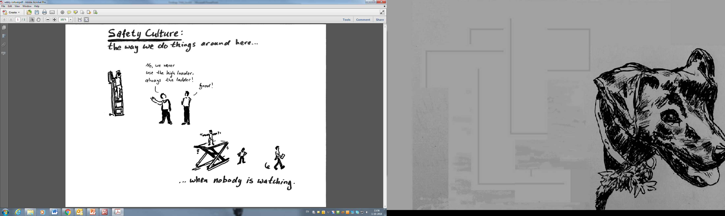


Slide 3
Long term goal
Improve the safety culture at the company to a level that equals the best in the industry
For all levels of the organization
Taking into account the local culture

Slide 4
First phase
Thorough assessment of the current safety culture :
per division (flight operations, maintenance, ground services, staff)
differentiated between managers and other employees
benchmarked against other airlines

Slide 5

Approach
Safety Culture perception
Safety Culture assessment results
Safety Culture prerequisites
Semi-structured interviews

Slide 6

First phase
Kick-off April 2018
Interviews June 2018
Surveys June – August 2018
Report to management October 2018

Slide 7
Safety culture perception survey
Aviation Safety Culture Inquiry Tool ASC-IT
Developed by NLR
Web-based
63 statements in local language
5-points scale
Example question
Please indicate to what extent you agree with the following statement:
I feel responsible for the safety of part of our operation
Strongly disagree Disagree Neutral Agree Strongly agree

Slide 8
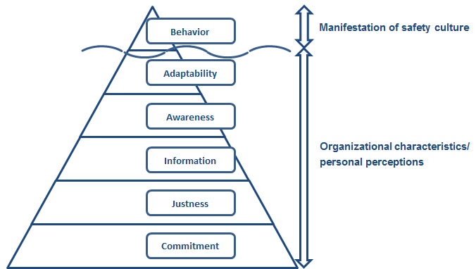
ASC-IT framework

Slide 9
Linking statements to the framework
Characteristics
Indicators
Statements
Statement 1
Management commitment
Statement 2
Statement 3
Statement 1
Commitment
Personal commitment
Statement 2
Statement 3
Statement 1
Investment in safety
Statement 2
Statement 3

Slide 10
Safety culture prerequisites (survey)
Developed by the Aviation Academy, the Safety Culture Prerequisites tool includes two separate assessments:
The extent to which the organisation has planned for a good safety culture;
The extent to which these plans have been implemented in practice
Six dimensions
general prerequisites
just culture
flexible culture
reporting culture
informative culture
learning culture

Slide 11
Interviewing process
Semi-structured interviews on safety culture topics
Team: 2 safety experts, 1or 2 cabin crew interpreters
51 interviews on site
All levels, several departments
Notes of the interviews were taken real-time, resulting in 200 pages of interview transcripts.

Slide 12
Results

Slide 13
ASC-IT survey participation

Slide 14
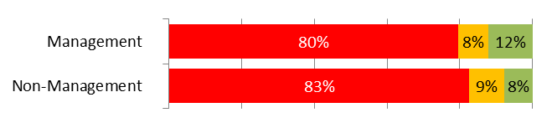
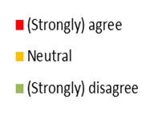
ASC-IT results (1)
“A lack of resources is affecting safety in my organisation”

Slide 15
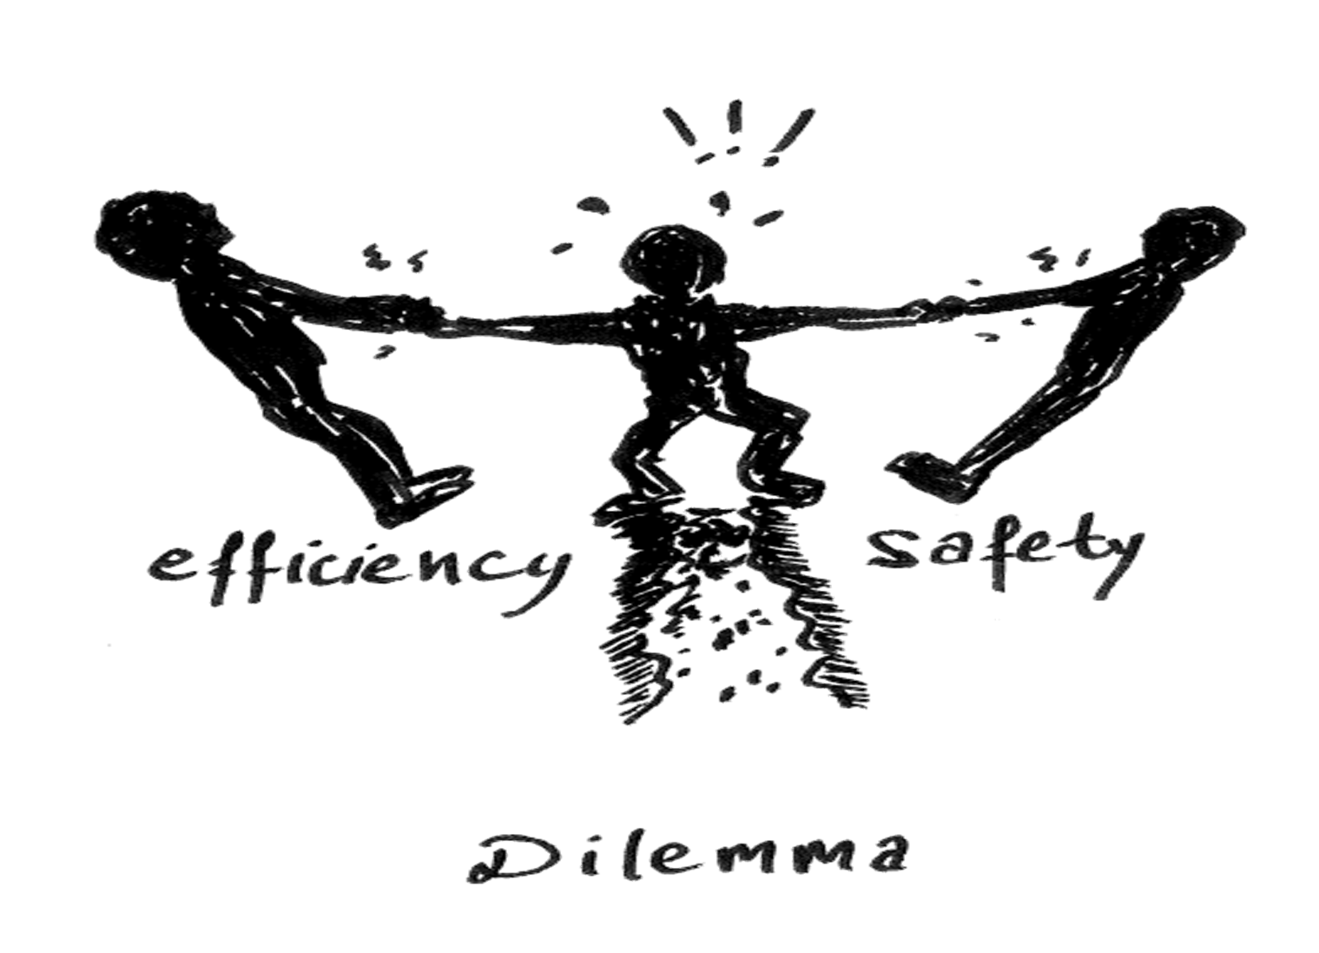

Slide 16
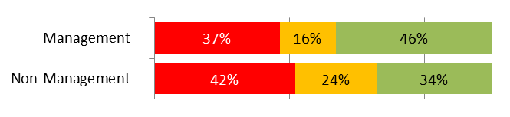
ASC-IT results (2)
“Incident investigations are focused on finding a party to blame”

Slide 17
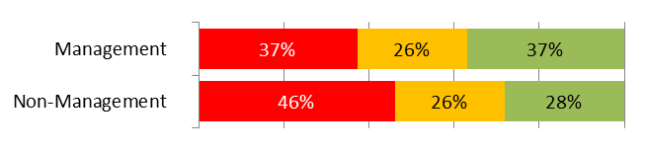
ASC-IT results (3)
“I only submit safety reports if I can remain anonymous /
Personnel only submit safety reports if they can remain anonymous”

Slide 18
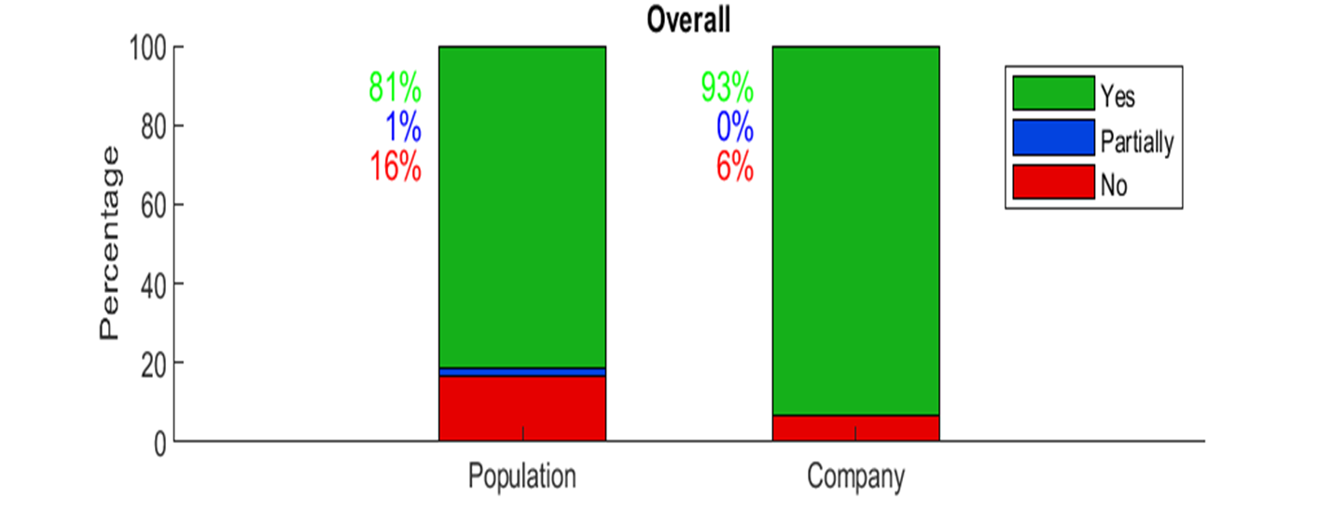
Safety culture prerequisites – results (1)
Planning scores are slightly better than the benchmark

Slide 19
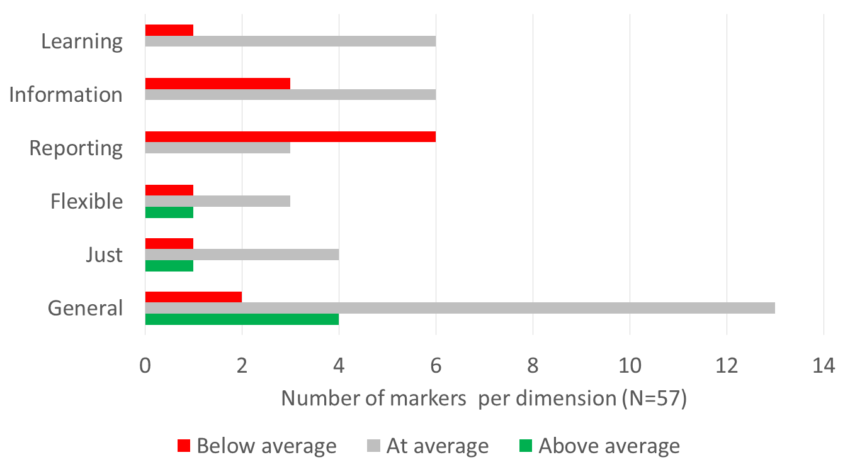
Safety culture prerequisites – results (2)
Implementation scores are lower than the benchmark

Slide 20
Interviews – Example result
“Last year I received not more than 20 safety reports.
About 3 – 4 issues per week come in through an on-line messaging platform”.

Slide 21
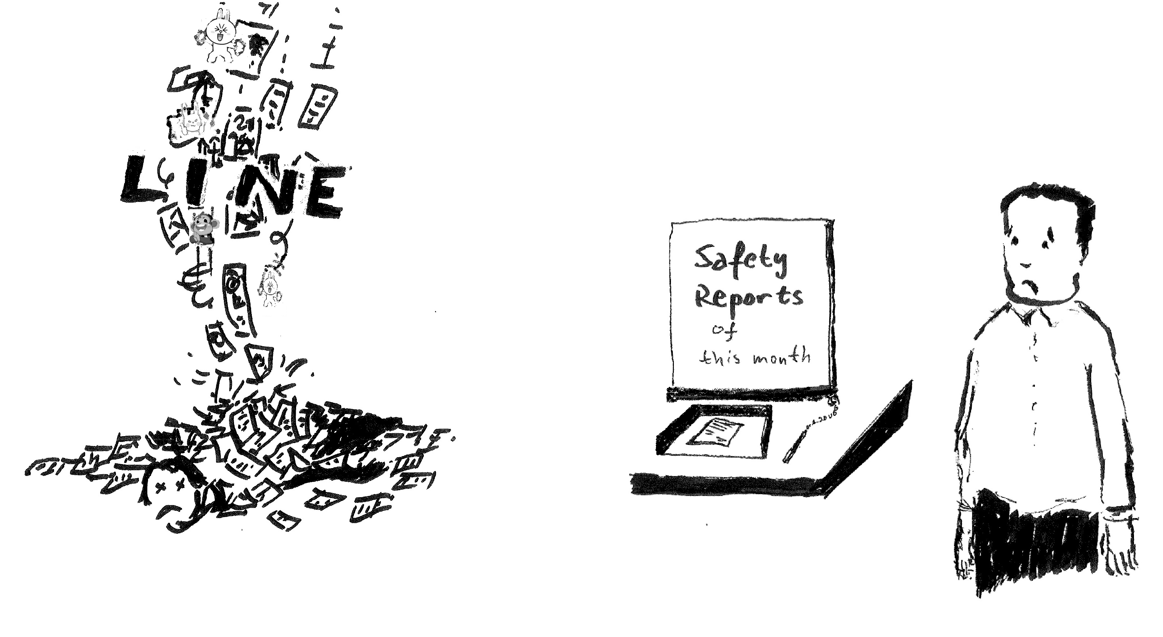

Slide 22
Combining the results

Slide 23
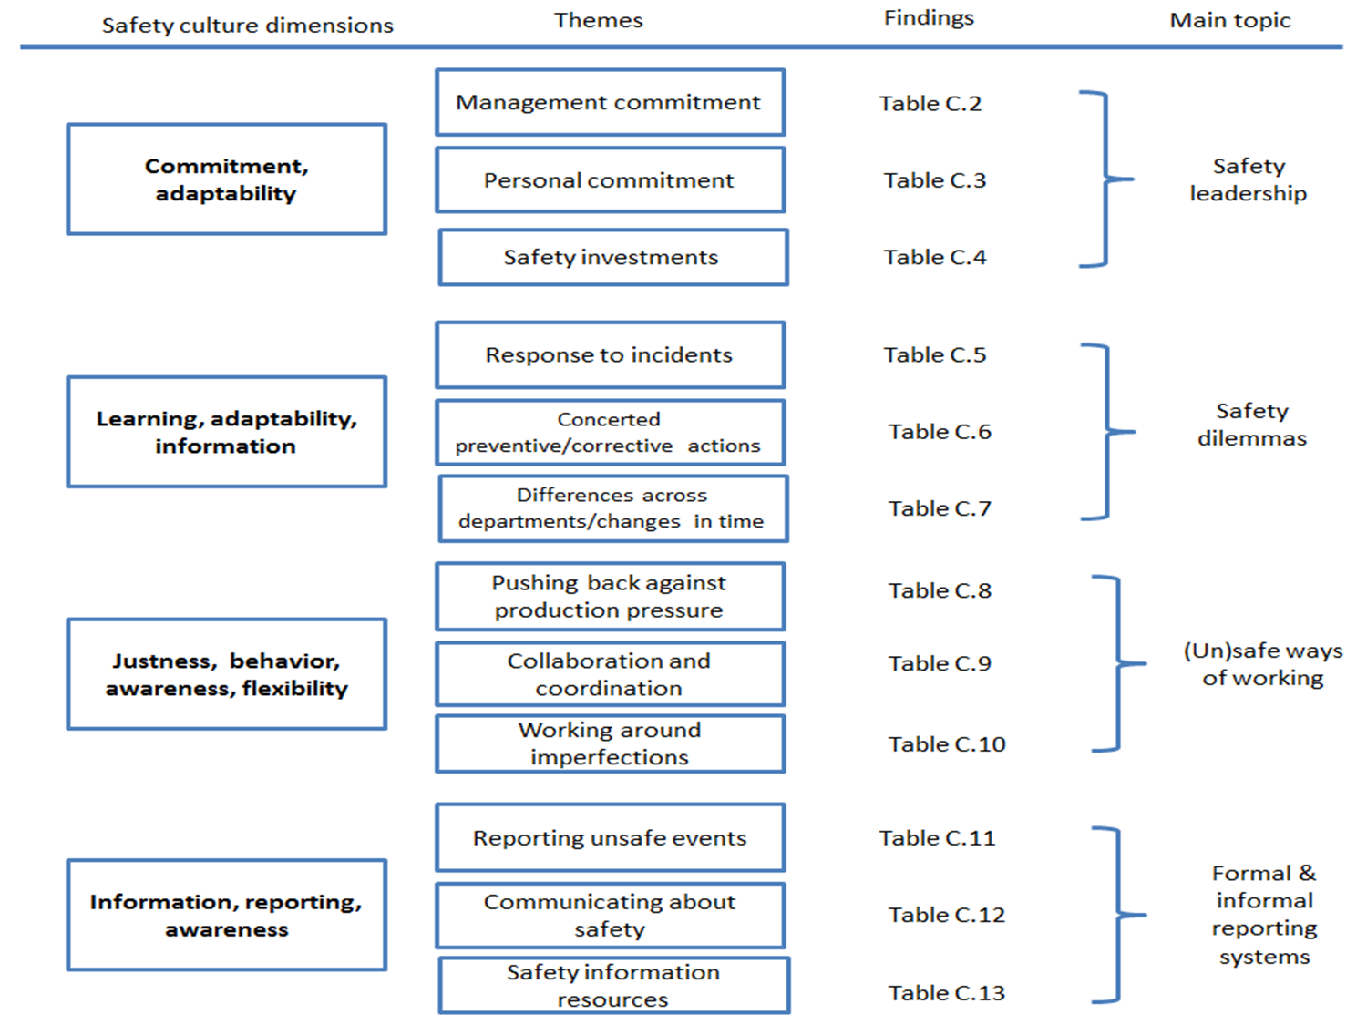

Slide 25
Conclusions - company
The safety culture at the company lags behind industry average.
Perception of lack of resources to achieve ambition
  The company can make significant steps on the path to an enhanced safety culture.
  Intermediate goals (rather than actions) to guide the company have not yet been set.
Commitment to safety is not always observed in practice
  Informal ways of working are condoned until incident occurs
  A blame culture exists
Dissatisfaction with (safety) training across the company
Safety reporting system not used sufficiently, opportunities missed
  Confidentiality
  Feedback
  Alternatives forms of communication used to inform each other instead

Slide 26
Conclusions - approach
Combination of ASC-IT, prerequisites tool and interviews provides complementary information.
Prerequisites tool provides immediate actionable recommendations for weaknesses observed in ASC-IT. The interviews provide context that allows specifying the recommendations to the company.

