Slide 1

Quality Management and Technology
Analysis and evaluation of accidents and incidents related to incorrect maintenance.

Slide 2
The Team
Tom Gkourlias, Hellenic Open University (Greece)
⎆Anastasios Plioutsias, National Technical University of Athens, NTUA (Greece)
Prof. Panagiotis Tsarouhas, Hellenic Open University (Greece)

Slide 3
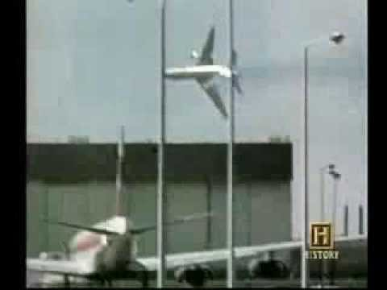
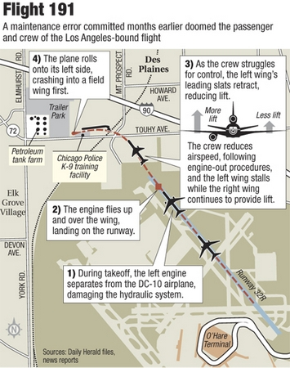
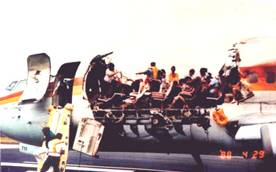
Accidents and Incidents

Slide 4
Structure
Maintenance error
Methodology
Maintenance accidents and incidents with P.E.A.R.
Maintenance accidents and incidents with DIRTY DOZEN
Results and comparison
Conclusions and Recommendations

Slide 5
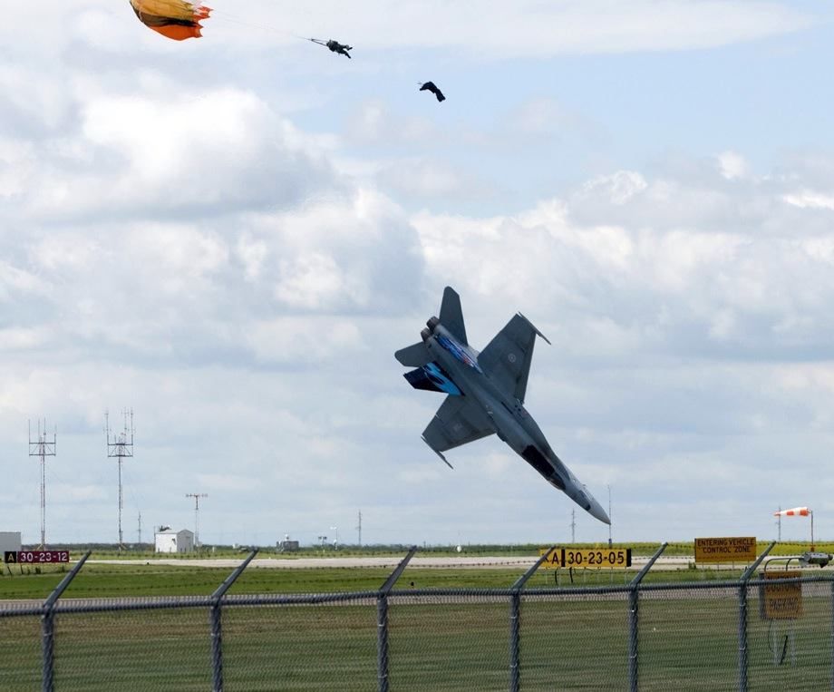
Aviation Maintenance
Accidents and Incidents according to maintenance error
Human Factors
The Scope of the research
Notes:
investigate events caused by maintenance technician and/or inspector performance.
Errors are the result of actions that fail to generate the intended outcomes. They are categorized according to the cognitive processes involved towards the goal of the action and according to whether they are related to planning or execution of the activity.
Οι μελέτες εξήντα ετών του ανθρώπινου παράγοντα, έχουν αποφέρει οφέλη στη μείωση των σφαλμάτων στη συντήρηση (Drury, 2000), στη βελτίωση της αποτελεσματικότητας (Endsley and Robertson, 2000) και στη βελτίωση χαρακτηριστικών και χρηστικότητας των εργαλείων και του εξοπλισμού (Hobbs, 2001).

Slide 6
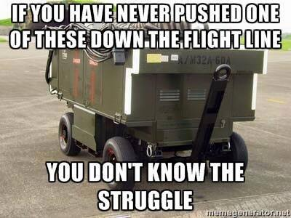
Scope of the research
Identify the interactions between human factors, to provide new data and similar incentives for further improvement in training and maintenance processes.

Slide 7
Phase of Research
1st Phase:
Find accidents and incidents reports in aviation maintenance.
PEAR and Dirty Dozen (DD) Analysis
2nd Phase:
An initial comparison between PEAR and DD
3rd Phase:
Group the effective factors

Slide 8
Aviation Incident or Accident Final Reports
National Transportation Safety Board (NTSB)
Federal Aviation Administration (FAA)
Aviation Safety Network (ASN)
Flight Safety Foundation
Air Force Magazine
http://www.planecrashinfo.com
http://www.aviation-accidents.net
http://www.aeroinside.com

Slide 9
Aviation Incident or Accident Final Reports
Assumptions
2005 up to 2017 (published final safety reports)
Only aircrafts (A/C, Fixed Wings)
Accidents and incidents in scheduled flights and maintenance
No experimental A/C
In research the extent of the damage and / or the number of casualties are not considered

Slide 10
Aviation Incident and Accident Final Reports
2653 safety reports evaluated
189 accident and incident reports were selected:
            Maintenance
      Repairs
      Services

Slide 11

P.E.A.R.
People who do the job;
Environment in which they work;
Actions they perform; and
Resources necessary to complete the job.
William B. Johnson, Ph. D, Michael E. Maddox, Ph.D

Slide 12
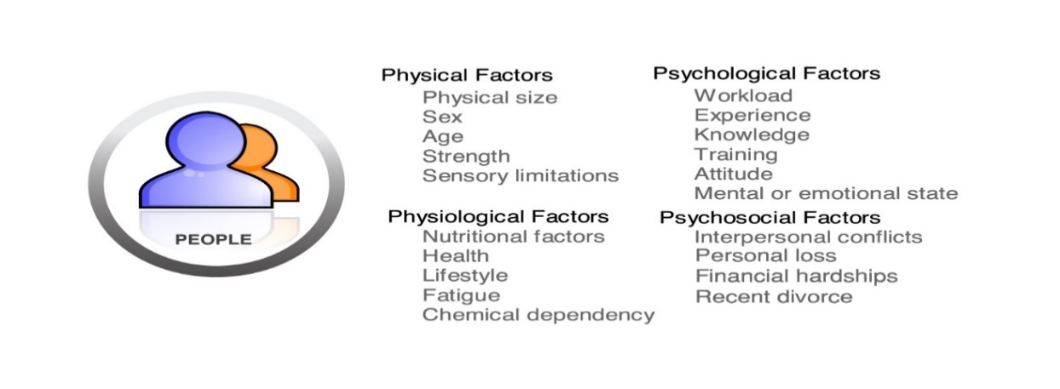
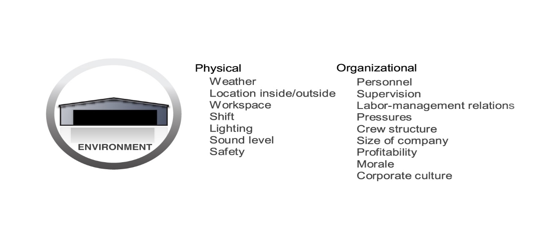
P.E.A.R.

Slide 13
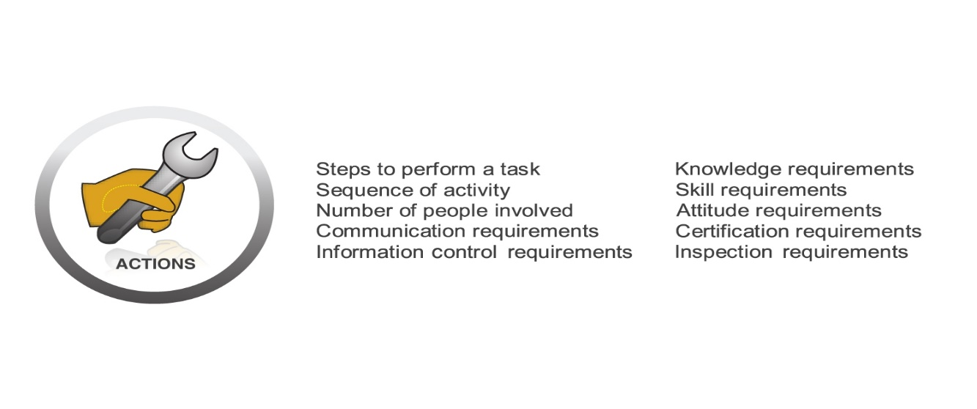

P.E.A.R.

Slide 14
P.E.A.R. results

Slide 15
P.E.A.R. results
Notes:
Όλα τα παραπάνω μας δείχνουν τα εξής:
Ο άνθρωπος εφόσον εργάζεται (τεχνικός) κάνει λάθη
Όταν ο τεχνικός δεν έχει στη διάθεση του τα κατάλληλα εργαλεία, έχει πολλές πιθανότητες να κάνει λάθος
Όταν οι συνθήκες εργασίας είναι αντίξοες, τότε οι πιθανότητες να γίνουν λάθη είναι αυξημένες
Όταν ένας τεχνικός έχει λάβει την κατάλληλη εκπαίδευση, χρησιμοποιεί τον σωστό και απαραίτητο εξοπλισμό, ενώ παράλληλα εργάζεται σε κατάλληλο περιβάλλον, οι προσωπικοί- ατομικοί παράγοντες δεν θα τον εμποδίσουν να εκπληρώσει με επιτυχία την εργασία του
Τα συμπεράσματα που μπορούν να εξαχθούν είναι τα εξής:
Στα 3/4 των ατυχημάτων – περιστατικών υπάρχει λάθος του τεχνικού
Στο 1/2 των ατυχημάτων – περιστατικών η έλλειψη των πόρων ενισχύει την πιθανότητα πρόκλησής τους
Στο 1/3 των ατυχημάτων – περιστατικών το αντίξοο περιβάλλον και οι ακατάλληλες συνθήκες εργασίας, αποτελούν επιβαρυντικό παράγοντα
Ο παράγων Άνθρωπος (φυσικές ικανότητες, φύλο, καταγωγή κα) συμβάλλουν μόνο στο 1/8 των ατυχημάτων - περιστατικών

Slide 16
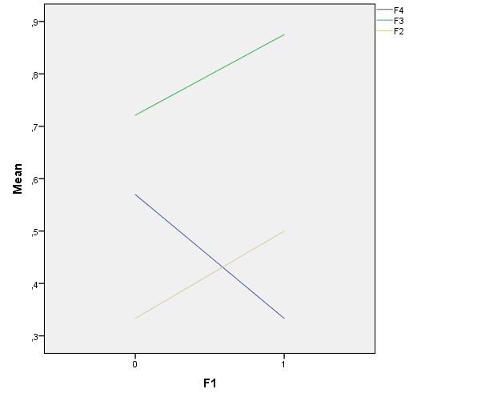
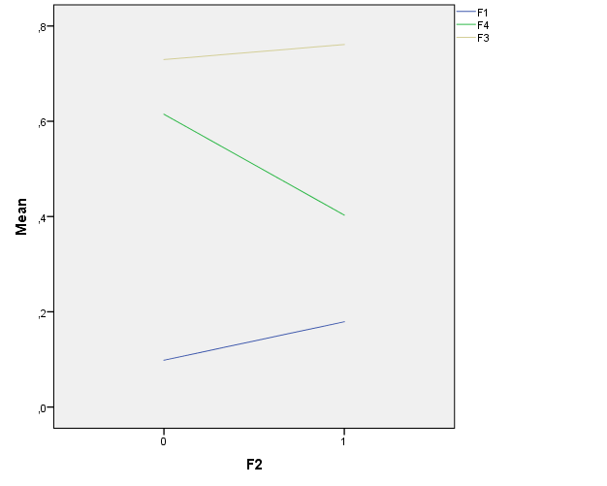
P.E.A.R. results
Line charts
Notes:
Η εμφάνιση του παράγοντα F1 (People) σε κάποιο περιστατικό (Σχήμα 3-4), φαίνεται να «διεγείρει» την εμφάνιση των παραγόντων F2 (Environment) και F3 (Actions), ενώ αντίθετα διεγείρει την μη εμφάνιση του παράγοντα F4 (Resources).
Η εμφάνιση του παράγοντα F2 (Environment) σε κάποιο περιστατικό (Σχήμα 3-5), φαίνεται να «διεγείρει» την εμφάνιση των παραγόντων F1 (People) και F3 (Actions), ενώ αντίθετα διεγείρει την μη εμφάνιση του παράγοντα F4 (Resources).

Slide 17
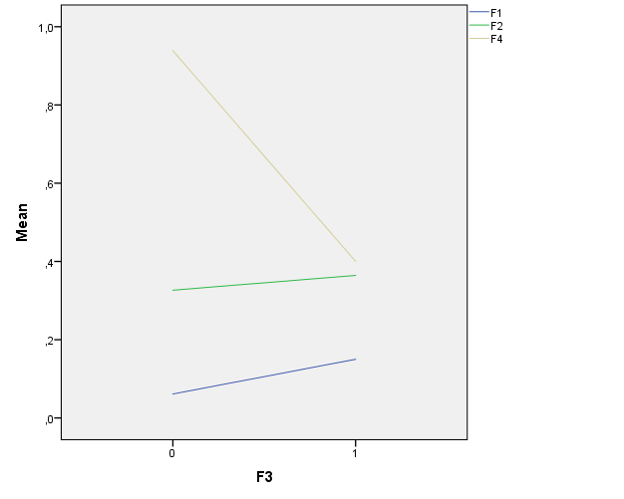
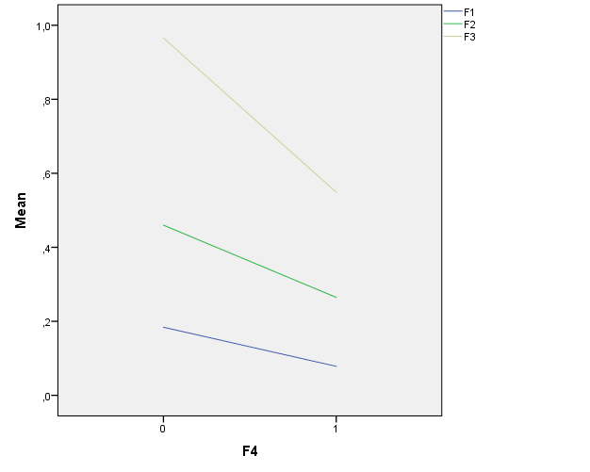
P.E.A.R. results
Line charts
Notes:
Η εμφάνιση του παράγοντα F3 (Actions) σε κάποιο περιστατικό (Σχήμα 3-6), φαίνεται να «διεγείρει» την εμφάνιση των παραγόντων F1 (People) και F2 (Environment), ενώ αντίθετα διεγείρει την μη εμφάνιση του παράγοντα F4 (Resources).
Η εμφάνιση του παράγοντα F4 (Resources) σε κάποιο περιστατικό (Σχήμα 3-7), φαίνεται να μην «διεγείρει» την εμφάνιση κανενός εκ των παραγόντων, ενώ αντίθετα φαίνεται να διεγείρει την μη εμφάνιση τους.

Slide 18
P.E.A.R. results
Chi-Square Tests
Factors | P-Value | Independence or dependence
F1 (People) - F2 (Environment) | 0.111>0.05 | Independence
F1 (People) - F3 (Actions) | 0.108>0.05 | Independence
F1 (People) - F4 (Resources) | 0.030<0.05 | Dependence
F2 (Environment) - F3 (Actions) | 0.634>0.05 | Independence
F2 (Environment) - F4 (Resources) | 0.005<0.05 | Dependence
F3 (Actions) - F4 (Resources) | 0.000<0.05 | Dependence

Slide 19
P.E.A.R. results
People (12,70%) gender, age, and other physical and psychological characteristics in maintainers, will not contribute to an accident if they:
works in a friendly environment in appropriate conditions
Supervision and guidance
Well and proper trained
Working with a quality assurance system
With resources and procedures
Environment (35,45%), the physical environment labors in addition to the Resources and in case of lack of resources the percentages of the environment increased to 45,97%. Working relationships, pressure, supervisor, e.g. must be must be improved.
Actions (73,54%) directly connected with resources. Lack of resources increased the percentages to 96.552%.
Resources (53,97%) significantly affect the other factors, and it depends on Environment and Actions.

Slide 20
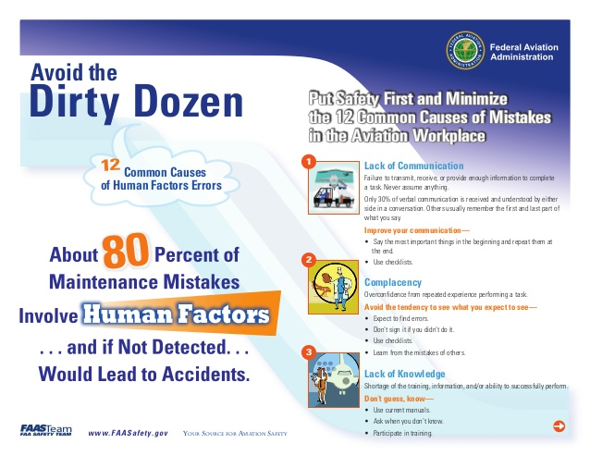
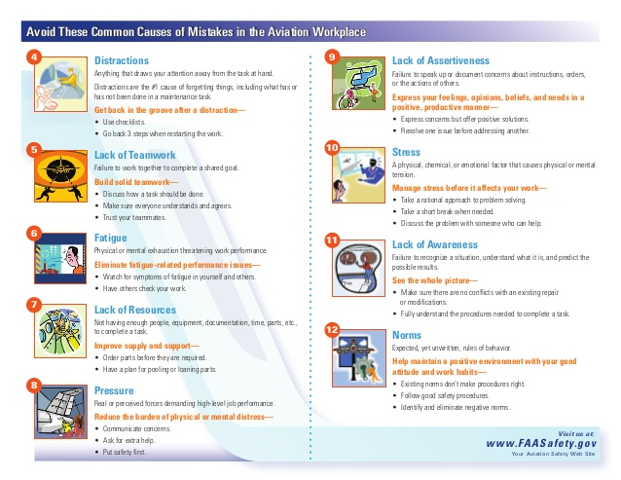
Dirty Dozen
Transport Canada
Gordon Dupont
ICAO 240-AN /144

Slide 21
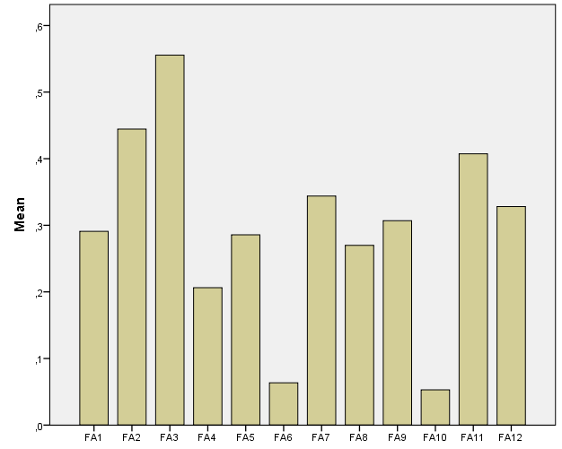
Dirty Dozen results
FA1 | LACK OF COMM
FA2 | COMPLACENCY
FA3 | LACK OF KNOWLEDGE
FA4 | DISTRACTIONS
FA5 | LACK OF TEAMWORK
FA6 | FATIQUE
FA7 | LACK OF RESOURCES
FA8 | PRESSURE
FA9 | LACK OS ASSERTIVEVNESS
FA10 | STRESS
FA11 | LACK OF AWARNESS
FA12 | NORMS

Slide 22
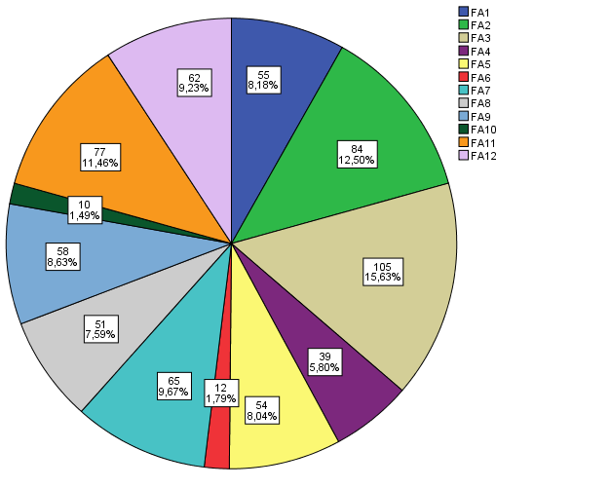
Dirty Dozen results
FA1 | LACK OF COMM
FA2 | COMPLACENCY
FA3 | LACK OF KNOWLEDGE
FA4 | DISTRACTIONS
FA5 | LACK OF TEAMWORK
FA6 | FATIQUE
FA7 | LACK OF RESOURCES
FA8 | PRESSURE
FA9 | LACK OS ASSERTIVEVNESS
FA10 | STRESS
FA11 | LACK OF AWARNESS
FA12 | NORMS

Slide 23
Dirty Dozen results
FA | FA (+) | FA(-) / NEUTRAL
FA1 | 4 5,10 | 3,6,7,9,11,12 - N: 2,8
FA2 | 2,4,8 | 3,7,9,11,12 – N: 1,5
FA3 | 7,9,10,12 | 1,2,4,5,6,9,11
FA4 | 1,2,5,10 | 3,4,6,7,8,9,11,12
FA5 | 1,4,6,8,10 | 3,7,9,11 – N:2,12
FA6 | 2,5,8,10 | 1,3,4,7,9,11 – N:12
FA7 | 3,9,12 | 1,2,4,5,6,7,8,10,11
FA8 | 2,5,6,10 | 3,4,7,8,9,11,12 – N:1
FA9 | 3,7,12 | 1,2,4,5,6,8,9,10,11
FA10 | 3,4,5,6,8,11 | 2,7,9,12
FA11 | 10 | 1,2,3,4,5,6,7,8,9,11,12
FA12 | 3,7,9 | 1,2,4,8,10,11,12 - N: 5,6
FA1 | LACK OF COMM
FA2 | COMPLACENCY
FA3 | LACK OF KNOWLEDGE
FA4 | DISTRACTIONS
FA5 | LACK OF TEAMWORK
FA6 | FATIQUE
FA7 | LACK OF RESOURCES
FA8 | PRESSURE
FA9 | LACK OS ASSERTIVEVNESS
FA10 | STRESS
FA11 | LACK OF AWARNESS
FA12 | NORMS

Slide 24
Dirty Dozen results
Chi-Square Tests
FA | P-Value | INDEP - DEP
FA3 - FA1 | 0.142 | INDEP
FA3 - FA2 | 0.024 | DEP
FA3 - FA4 | 0.000 | DEP
FA3 - FA5 | 0.746 | INDEP
FA3 - FA6 | 0.109 | INDEP
FA3 - FA7 | 0.231 | INDEP
FA3 - FA8 | 0.442 | INDEP
FA3 - FA9 | 0.014 | DEP
FA3 - FA10 | 0.771 | INDEP
FA3 - FA11 | 0.817 | INDEP
FA3 - FA12 | 0.155 | INDEP
FA1 | LACK OF COMM
FA2 | COMPLACENCY
FA3 | LACK OF KNOWLEDGE
FA4 | DISTRACTIONS
FA5 | LACK OF TEAMWORK
FA6 | FATIQUE
FA7 | LACK OF RESOURCES
FA8 | PRESSURE
FA9 | LACK OF ASSERTIVENESS
FA10 | STRESS
FA11 | LACK OF AWARNESS
FA12 | NORMS

Slide 25
Dirty Dozen general results
Lack of knowledge (55.6%), complacency (44,4%) and lack of awareness (40,7%) are the most likely factors in accidents or incidents.
Fatigue (6,3%) and stress are less probable factors (Main.)
Lack of communication stimulates distractions lack of teamwork and stress, but not stimulates lack of knowledge, fatigue, lack of resources, lack of assertiveness, lack of awareness and norms. Also does not significantly affect complacency and pressure.
Lack of communication associated with the appearance of distractions lack of teamwork, lack of resources and lack of assertiveness.
The probability of lack of communication occurrence it depends on the presence of distraction and/or lack of teamwork (57.563% only with lack of teamwork and 79.993% with teamwork and distraction).

Slide 26
Dirty Dozen results
Lack of communication (29,1%) is an essential factor when combined with distraction and lack of teamwork.
Complacency (44,4%) appears with stress, lack of resources and lack of assertiveness.
Lack of knowledge is the most probable factor in maintenance accident ad incidents (55,6%)
The probability of Distractions (20,6%) appearance increased with stress especially in cases when maintainers have the resources, the knowledge, and the assertiveness.
Lack of teamwork (28,6%) depends on a lack of communication.
Fatigue is a factor with low probability appearance in maintenance accidents and incidents with 6,3%. Fatigue connects with pressure.

Slide 27
Dirty Dozen results
Lack of resources (34,4%) followed with a lack of norms and lack of assertiveness.
Pressure (27,0%) significantly associated with fatigue.
Lack of assertiveness (30,7%) and especially when they coexist lack of knowledge and lack of resources.
Stress (5,3%) is the lowest probable factor, while any distraction enhances the likelihood of its presence.
Lack of awareness (40,7%) and has to do with the knowledge of the consequences of the actions.
Norms (32,8%) and is significantly dependent on the availability of resources.

Slide 28
Comparison of results
Factors related to the individual, personal, physiological and psychological characteristics (PEAR) and fatigue and stress (DD) have the lowest incidence rates in accidents - incidents due to maintenance errors with the same statistical results.
The Environment (PEAR) and distraction, stress, and norms (DD), have 20,6% to 35,4%, with the same statistical results.
Actions (PEAR) and lack of communication, complacency, lack of teamwork and lack of assertiveness (DD) ranging from 28,6% to 73,5%. This significant variation is mainly due to the division of accidents into more categories in DD.
The Resources as factors are almost identical in PEAR and DD. In PEAR with 53,97%, but in DD with 34,4%. This remarkable difference is also due to the categorization of models, as the lack of training is not included in the Lack of Resources (PEAR) but in the Lack of Knowledge for the DD.

Slide 29
Comparison of results
Lack of norms, TO, documents and working cards leads to failures and mistakes.
Training can perform specialized tasks.
The availability of resources reduces the stress of the technician and allows them to focus on the proper job performance.
A quality system provides training, ensures and support every job in maintenance.

Slide 30
Recommendations
Human resource management and expertise in aviation and occupational safety.
Appropriate environment and availability in resources, special equipment and PPE.
Teamwork and communication improvement.
Safety culture.
Pressure decreased with human resources management.
Norms, documents and record files.
Training improvement and updated.
An integrated quality assurance system.

Slide 31
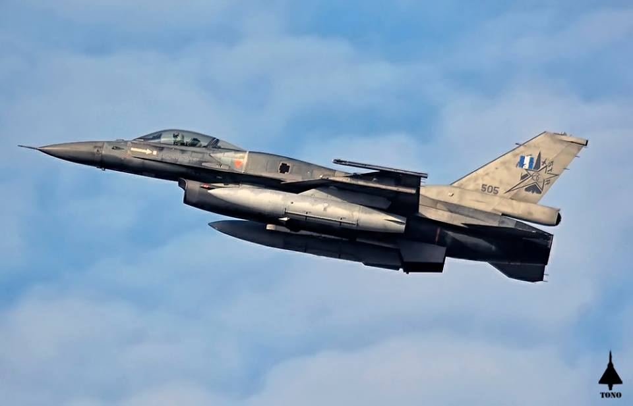
  Thank you for your attention!

