Slide 1
Restorative Just Culture
A study of the practical and economic effects of implementing restorative justice in an NHS trust
ICSC – Amsterdam – 2nd Nov 2018
Mannat Kaur¹
Robert J. de Boer^{1,2}
Amanda Oates³
Joe Rafferty³
Sidney Dekker^{1,4}
¹ Art of Work Solutions Pty. Ltd., Brisbane, Australia
² Northumbria University Amsterdam Campus, the Netherlands
³ Mersey Care NHS Foundation Trust, Liverpool, UK
⁴ Griffith University, Brisbane, Australia

Slide 2
Outline
Background
Literature
Research Objective
Approach
Findings
Conclusion
Background
Literature
Research Objective
Approach
Findings
Conclusion

Slide 3
NHS Mersey Care
Mersey Care is a community and mental health trust providing care for a population of over 11 million patients in the North West of England & more
It is the largest provider of learning disability forensic secure care and is one of three providers of high secure services in the UK
It employs ~8,000 staff members across 80 plus sites
Background
Literature
Research Objective
Approach
Findings
Conclusion

Slide 4
Decision for change
Current managerial & supervisory practices were not leading to desired improvements
In 2015, Mersey Care decided to adopt Restorative practices as an alternative to the traditional approach following incidents .
18 months
Just and Learning Culture
Background
Literature
Research Objective
Approach
Findings
Conclusion

Slide 5
Interventions
Freeze of staff suspensions
Investigations replaced by restorative conversations
Myth-busting sooner than later
Discarding judgemental language; focus on clarity, necessity and staff empowerment
Background
Literature
Research Objective
Approach
Findings
Conclusion

Slide 6
Interventions
Sharing good practice stories (lessons, confessions, gratitude)
Trickle down of restorative culture in everyday organizational life
Staff support: advertising, psychological first-aid, follow-ups etc.
Promoting the awareness of restorative culture
New roles: Just & Learning Culture (JLC) lead and ambassadors
Background
Literature
Research Objective
Approach
Findings
Conclusion

Slide 7
Retributive & Restorative Justice
Retributive [Marx 2001, Reason 1997, Wachter & Pronovost 2009, Dekker & Hugh 2010, Dekker & Laursen 2007, Dekker & Breaky 2016, Dekker 2009] | Restorative [Braithwaite 1989, Sharpe 2003, 2004, Berlinger 2005, Dekker 2016]
Focus on compliance | Focus on the victims
Who made the mistake? How major are these errors? What should be the proportional repercussions? | Who is hurt? What do they need? Whose obligation is it to meet those needs?
Discouraged reporting | Encouraged reporting
Staff is under pressure | Staff support
Fear of blame | Opportunity to learn
Background
Literature
Research Objective
Approach
Findings
Conclusion

Slide 8
Research Objective
To identify and substantiate the practical and economic effects of Restorative Practice at Mersey Care NHS Foundation Trust
Expected to see changes in:
                Disciplinary cases and associated costs
                Incident reporting
                Termination costs
                Staff morale
Background
Literature
Research Objective
Approach
Findings
Conclusion

Slide 9
Approach
Researchers were present at the Trust headquarters and various other sites.
Access to accounting records, policies and procedures.
Personal and detailed staff interviews with:
    CEO
    Executive Director of Workforce
    Head of Health and Well-being
    Deputy Director of Workforce
    Head of the Finance team
    Business Intelligence team
    Strategic Advisor Digital Programmes
    Staff Side Chair
    Deputy Medical Director
    Strategic Organizational Effectiveness Lead
    Head of Organizational Effectiveness and Learning
The practical and financial analysis was performed off-site.
Several HR policies (disciplinary, attendance etc.) were also assessed.
Background
Literature
Research Objective
Approach
Findings
Conclusion

Slide 10
Staff experience
Increase in
Good faith and trust
Decrease in
Tendency to start an investigation
Knee-jerk reactions
Psychological stress of the staff
Time to process special payments
Staff engagement (also with senior management)
Staff motivation and morale
Job satisfaction
Compassion
Sense of personal learning
Staff support
Background
Literature
Research Objective
Approach
Findings
Conclusion

Slide 11
Staff experience
Changing perspective around accountability and human error
Recognizing 2nd victims and providing support
Increased staff ability to work in-line with the leadership programmes
Open & accommodating work environment, facilitates honesty and learning
Awareness of a restorative culture can diffuse stressful situations
Connection between patient and staff safety
Safety is top priority
Background
Literature
Research Objective
Approach
Findings
Conclusion

Slide 12
HR policy review
Policies and procedures reviewed:
    HR01 – Disciplinary Procedure
    HR07 – Management of Attendance
    SA03 – Reporting, Management & Review of Adverse Incidents
    HR37 – Supporting Colleagues
Judgemental language was present, however, so was explicit reference to embody restorative values
HR37 policy has been established as a result of cultural change
Background
Literature
Research Objective
Approach
Findings
Conclusion

Slide 13
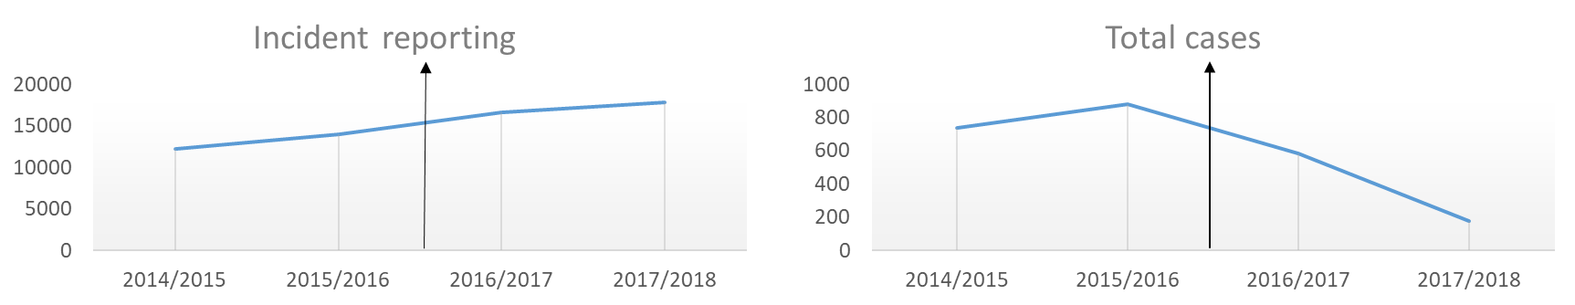
Practical effects
Increase in staff coming in for support (f2f counselling)
Decrease in issues presented regarding bullying, career, formal procedures, health, job situation, employment, trauma and violence/assaults
Deceleration of the increasing trend of sickness absence, staff-turnover
Background
Literature
Research Objective
Approach
Findings
Conclusion

Slide 14
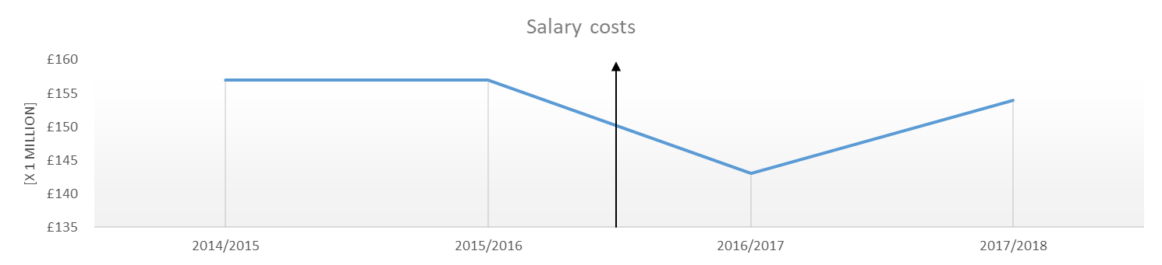
Economic effects
Total savings of £4 mio per year (2.2% of total costs) in salary costs
Half of these are conservatively attributed to restorative practices
Background
Literature
Research Objective
Approach
Findings
Conclusion

Slide 15
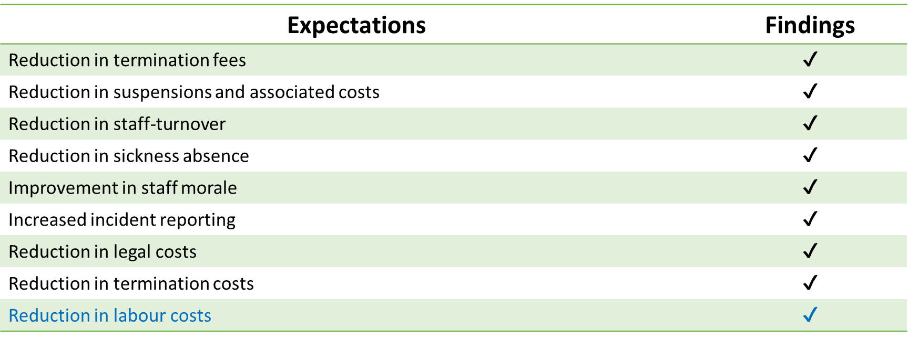


Expectations and findings
Background
Literature
Research Objective
Approach
Findings
Conclusion

Slide 16
Conclusions
Restorative justice implementation has beneficial effects for staff and organization alike.
Practical benefits:
      Reduction in disciplinary and suspension cases
      Increase in staff coming in for support (f2f counselling)
      Reduction in sickness absence
      Improved staff retention
      Improved staff morale and psychological safety
      Improved incident reporting
Economic benefits:
      Meaningful savings of 1% of total costs can conservatively be attributed to restorative practices
Background
Literature
Research Objective
Approach
Findings
Conclusion

Slide 17
Discussions
Analysis and estimations are based on a short time-frame following the interventions, hence, sustainability of these improvements remains to be seen
No benchmark information was available due to the unique setting of this project
Goals reached:
      Moral engagement of stakeholders
      Reintegration of the caregivers into their community of practice
      Psychological/emotional healing of those affected by any incident
      Organizational learning and improvement
Background
Literature
Research Objective
Approach
Findings
Conclusion

Slide 18

Thank you!
Mannat Kaur
TU Delft | PhD Researcher
@ m.kaur@tudelft.nl

