Slide 1



Nonlinear Degradation of System Configuration During the Development of an Accident
Dr Mikela Chatzimichailidou, WSP UK & Imperial College London
Dr Nektarios Karanikas, Aviation Academy Amsterdam

Slide 2

Scoping
Case study
Methodology
Analysis & Results
Take-aways

Slide 3
Background
Degradation in Situation Awareness (SA) can lead to safety issues (BFU 2002; Johnson 2004)
System elements, e.g. traffic collision avoidance system (TCAS), should not result in the degradation of SA (Masys 2005)
Accident investigators need to understand
    what elements of SA are lost
    what control and coordination transactions between human and non-human agents are either inadequate or required but not present (Salmon, Walker and Stanton 2015)

Slide 4
Definitions
Chatzimichailidou and Dokas 2015:
  risk awareness is a key factor for system safety
  systems carry an inherent awareness capability directly affected by their mechanisms
Risk SA
  is the awareness of an agent about the presence of system-induced or external threats and vulnerabilities that may lead a system to unfavourable states
  is facilitated by all necessary system features and functions = RiskSOAP mechanisms or elements

Slide 5
RiskSOAP
Methodology
Phase 1.
Step 1.1: Perform the STPA hazard analysis
Step 1.2: Perform the EWaSAP approach
Phase 2.
Step 2.1: Create the “ideal” vector; desired system composition
Step 2.2: Create the “real” vector; as-is system composition
Phase 3.
Step 3.1: Measure the RiskSOAP capability with the RiskSOAP indicator
Applied to all systems elements, i.e. sensors, feedback mechanisms, components and requirements needed to allow the system to meet its objectives

Slide 6
Case study: The Überlingen Mid-air Collision

Slide 7








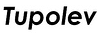
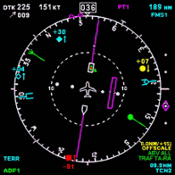
German Air Traffic Control system
Swiss Air Traffic Control system

Slide 8
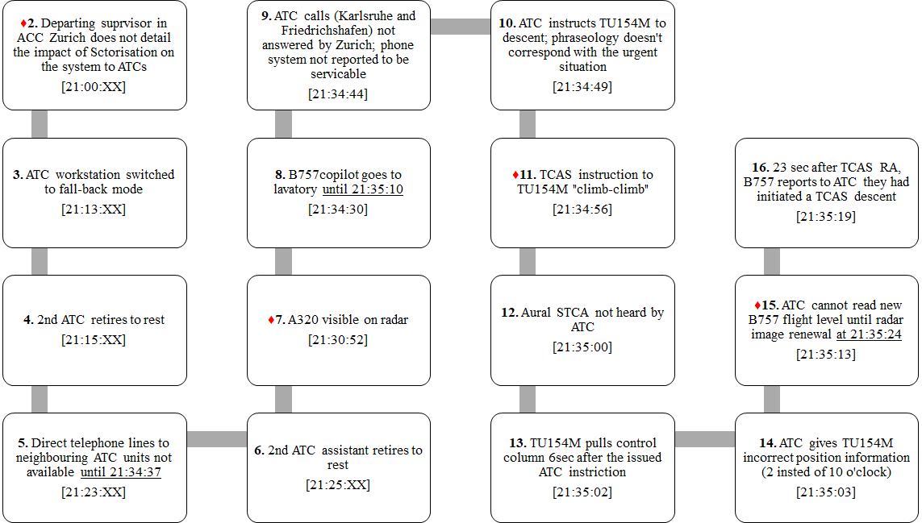

Slide 9
Results and Findings

Slide 10
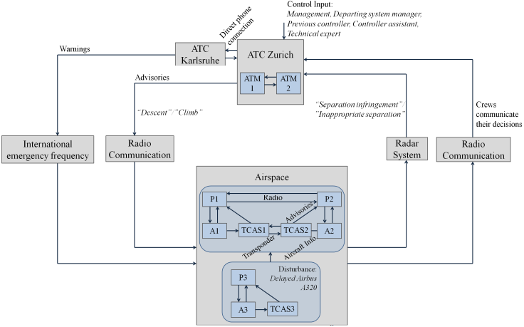
Safety control structure

Slide 11
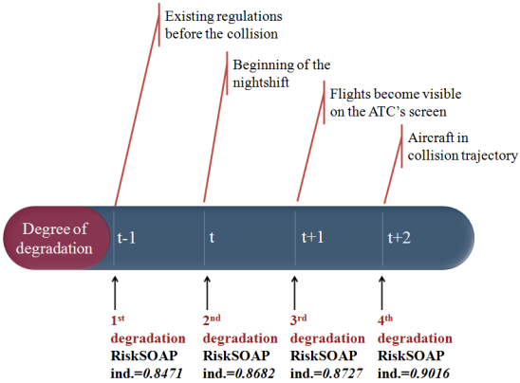
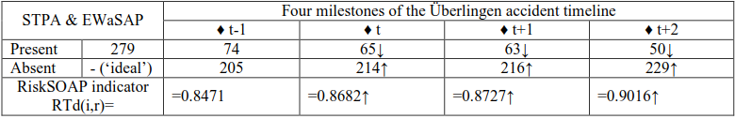

Previous post-accident analysis

Slide 12
vs Chatzimichailidou and Dokas (2015)
  Accident timeline broken down further into seventeen critical points
  The results
    allowed the graphical representation of the RiskSOAP values over time with higher detail than the original application of the methodology and
    revealed the increasing deviation of system configuration from its ideal version as the system was marching towards its total failure

Slide 13
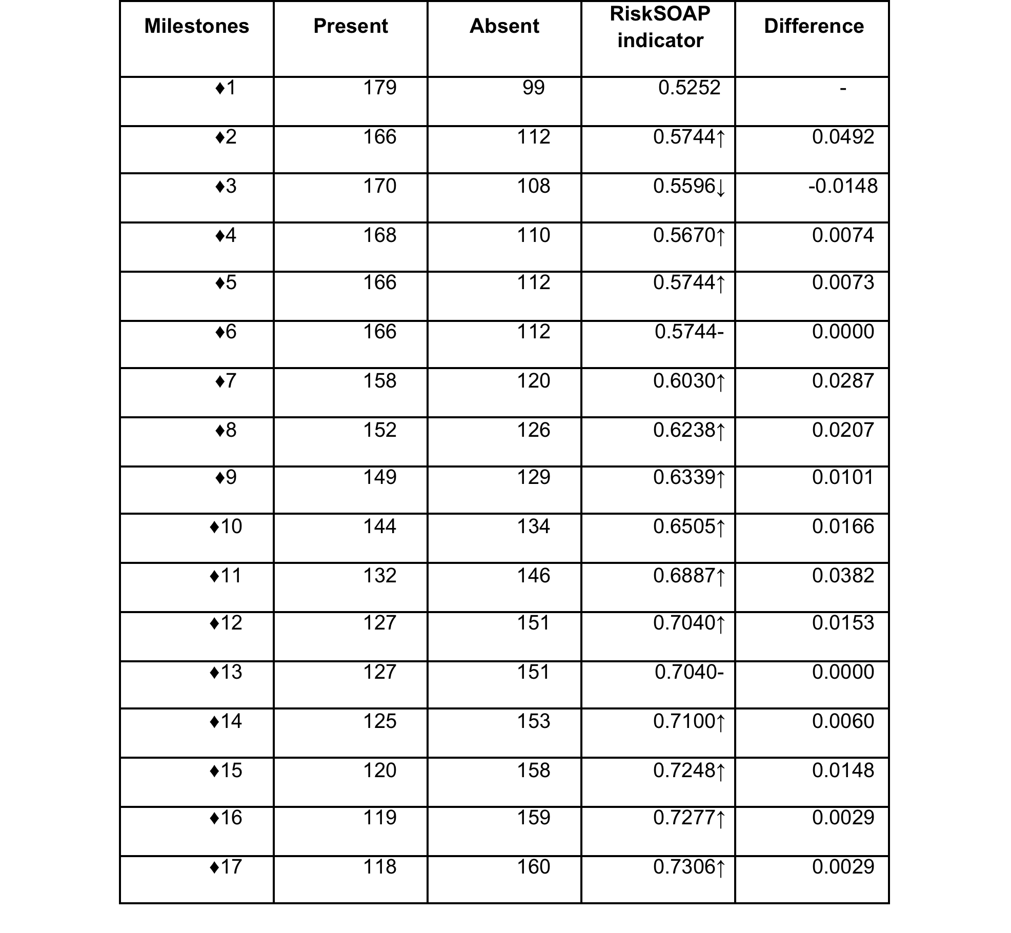

Slide 15
Key take-aways
  The findings provide support that socio-technical systems
    have non-linear behaviours
    drift into failure incrementally (Dekker 2012)
  The accident occurred just a few seconds after the RiskSOAP indicator reached a critical value (i.e. 1<0.7306)
    Not necessary to violate every safety constraint and miss all system elements to lead a system to catastrophe
  One system element may compensate for the degradation of the RiskSOAP capability caused by the loss or misbehaviour of another system element (i.e. ♦3)
  Positive association between the RiskSOAP capability and safety

Slide 16
Conclusions
  The capability of a system to accomplish its mission successfully deteriorates in a nonlinear manner
  The critical RiskSOAP values cannot be generalised; each event has its own context and each system has its own configuration
  Further studies will provide indications of the size of the gap between ideal and real system configurations
  Application of the COSYCO indicator (Karanikas and Chatzimichailidou 2018) to consider:
    the system level each requirement is (partially) met or not
    dependencies of each element on other system components

Slide 17
Thank you!
Contact us
Mikela: Mikela.Chatzimichailidou@wsp.com
Nektarios: n.karanikas@hva.nl

