Slide 1
Tracing New Safety Thinking Practices in Safety Investigation Reports
Dr Nektarios Karanikas
Aviation Academy, Amsterdam University of Applied Sciences (NL)
Dimitrios Chionis MSc, PhD candidate
Bolton University (UK)
3rd International Cross-industry Safety Conference (ICSC)
Amsterdam, 31 October – 2 November 2018

Slide 2
Older vs newer safety practices (1)
Older safety thinking & practices (OSTPs) | Newer safety thinking & practices (NSTPs) | Short title of NSTP | Code
Human error can be the principal cause of accidents. | Human error is always the result of deeper troubles within a system. | Human error seen as symptom | HES
Looking to the event backwards and simply detecting failures, errors, inaccurate assessments and wrong decisions. | Considering why choices made sense to users at that time and what options they had before each decision and action. | Hindsight bias minimisation | HBM
Focus on the end-user(s) without examining influences of other organisational/system levels. | End-user must not be the only focal point, and organisational/systemic factors must also be investigated. | Shared responsibility | SHR
Shared responsibility might be recognised, but an emphasis is given mainly on the end-user level. | Proportional investigation depth of all organisational/system functions. | Non-proximal approach | NPA
Constructs and ill-defined concepts (e.g., culture, complacency) can be named as accident causes. | Constructs and folk models must be decomposed and adequately explained. | Decomposition of folk models | DFM

Slide 3
Older vs newer safety practices (2)
Older safety thinking & practices (OSTPs) | Newer safety thinking & practices (NSTPs) | Short title of NSTP | Code
Standards and procedures constitute the unquestionable basis for comparing human performance. | Examining the assumptions on which standards are based and explaining reasons for deviating from standards, including the investigation of the applicability of standards to the context of the event. | Non-counterfactual approach | NCA
Actions and decisions are judged against established norms and expectations (e.g., experience and training). | Examining the validity of established norms and expectations and explaining the reasons for not meeting expectations. | Non-judgmental approach | NJA
Emphasis on explaining failures where humans are seen as a potential hazard. | Humans are seen as a resource necessary for system flexibility and resilience. Need to explain successes in addition to failures. | Safety-II | SII
End-users must maintain their awareness and are responsible for being always and fully knowledgeable of their system’s state. | Feedback mechanisms are examined to identify whether/how system awareness and control are maintained. The effectiveness of feedback must be investigated. | Feedback loops examination | FLE

Slide 4
Safety/accident model groups
Type | Brief description | Example model(s) | Code
Sequential | Direct cause-effect relationships: clearly defined timeline of failures, errors and violations that lead to an event. | Domino | SEQ
Epidemiological | Direct and indirect cause-effect relationships: clearly defined timeline of active failures along with long-lasting effects of latent problems that contribute to active failures. | Swiss cheese | EPD
Systemic | Dynamic, emerging and complex system behaviours: examining interactions, interdependencies and relationships between parts to understand a system as a whole, including effects of the behaviour of individual elements. | STAMP AcciMap | SYS

Slide 5
Study objectives & context
Objectives:
  Examine the degree to which the nine aspects of new safety thinking and the three categories of safety models have been visible in safety investigations published between 1999 and 2016.
Context:
  Extend previous research that looked at traces of new safety thinking in investigation reports as a means to detect gaps between knowledge and practice in the field of investigations as well as to examine differences between regions.

Slide 6
Research outline
Tool development:
  Analysis aim: identify whether each of the aspects was visible at least once in each report
  Six pilot sessions to achieve adequate inter-rater agreement (0.82).
External variables
  authority which issued the investigation report
  the year it was published
  actual involvement of end-users into the development of the event (YES/NO)
  whether the event resulted in fatalities (YES/NO)

Slide 7
Analysis tool: example
NSTP | Code | Question used to analyse safety investigation reports
Human error seen as a symptom | HES | Did the investigators search for factors which contributed to the human errors identified?
Hindsight bias minimisation | HBM | Did the investigators follow a forward chronological timeline to explain the choices of the end-users out of the options they had and/or why it made sense to them at that time?
Shared responsibility | SHR | Did the investigators mention various organisational/systemic factors which contributed to the event?
Non-proximal approach | NPA | Did the investigators search the organisational/systemic factors that contributed to the event to the same extent they did for the proximal causes (e.g. human errors of end-users and technical failures)?

Slide 8
Sample distribution
277 reports published between 1999 and 2016.
Variables, number of reports (N), and valid percentages (%)
Authority | Period | Fatalities
AIA1, N=60, 21.7% | ≤ 2006, N=140, 50.5% | YES, N=99, 35.7%
AIA2, N=45, 16.2% | ≥ 2007, N=137, 49.5% | NO, N=178, 64.3%
AIA3, N=52, 18.7% | End-user involvement
AIA4, N=60, 21.7% | YES, N=169, 61.0%
AIA5, N=60, 21.7% | NO, N=108, 39.0%

Slide 9
hypotheses
HYP1: Over time, there has been an increase of application of all NSTPs during safety investigations.
HYP2: There are differences amongst regions regarding the extent to which the NSTPs are applied.
HYP3: The NSTPs have been applied to the same extent regardless of the involvement of the end-users in the development of the event.
HYP4: The NSTPs have been applied to the same extent regardless of the existence of fatalities as a result of the event.

Slide 10
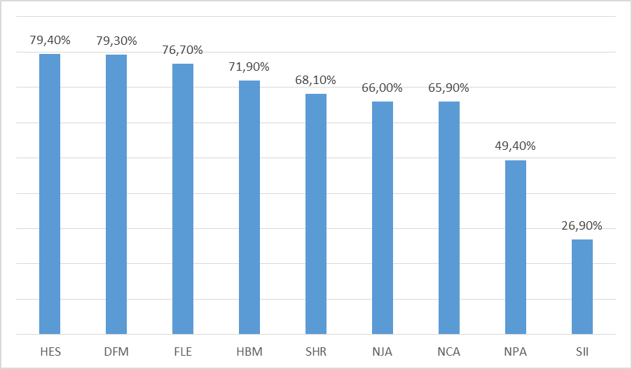
Results: overall frequencies

Slide 11
Results of statistical tests for the authorities
Hindsight Bias Minimisation (N=260)
  AIA2 highest (93.3%)
  AIA3 lowest (45.7%)
Shared responsibility (N=263)
  AIA4 highest (85%)
  AIA5 lowest (45%)
Non-proximal approach (N=261)
  AIA2 highest (75%)
  AIA5 lowest (20%)
Safety-II (N=275)
  AIA2 highest (53.3%)
  AIA5 lowest (13.3%)
Safety model family (N=268)
  Sequential
    AIA4 highest (63.8%)
    AIA1 lowest (24.1%)
  Epidemiological
    AIA1 highest (75.9%)
    AIA4 lowest (36.2%)

Slide 12
Results of statistical tests for the variables of period, end-user involvement and fatalities
NSTP (N) | Variables (% of cases in which the aspect was traced)
 | Time period |  |  | Fatalities
 | ≤ 2006 | ≥ 2007 | p value* | Yes | No | p value*
Safety-II (N=275) | 19.4 | 34.6 | p=0.005
Feedback loops examination (N=275) |  |  |  | 67.7 | 81.8 | p=0.008

Slide 13
Hypotheses (dis)proof
HYP1 (Change over time): Confirmed only for Safety-II
HYP2 (Differences amongst authorities): Confirmed for four aspects and the family models
HYP3 (Effects of end-user involvement): Rejected
HYP4 (Effects of fatalities): Confirmed only for Feedback Loops Examination

Slide 14
What could the results suggest for NSTP?
80% of “human error seen as a symptom” → it has been advocated long before recent literature was published.
75% of “decomposition of folk models” and “feedback loop examination” →prevalence of engineers in the safety investigations field:
  Avoid the labelling of constructs
  Examine whether systems provided to the end-users with adequate information about the state and outcomes of processes
72% “hindsight bias minimisation” → it seems that investigators might (not yet) fully comprehend that a backwards research will merely uncover the “what” and “why”, and not “how” it happened.

Slide 15
What could the results suggest for NSTP?
68% “shared responsibility” → it has been advocated long before recent literature was published; latent problems influencing human performance include technology-related factors.
66% “non-judgmental” and “non-counterfactual” → investigators put some efforts to examine the applicability and validity of standards and expectations within the context of each occurrence.
50% “non-proximal approach” → maybe decisions made and the actions performed long before the event cannot be always evidently traced or explained.
27% “Safety-II” → prevalent practice of addressing failures as part of the learning process and the focus of safety and accident models on system failures.

Slide 16
The overall messages
All new safety thinking practices were more or less visible across the whole sample.
NSTPs are relevant to investigators and not completely unknown.
Frequencies of implementation per NSTP can be attributed to:
  Individual Factors
  Organisational Factors
  Systemic factors
  Constraints that might influence investigation professionals
NSTPs might have been part of investigation practice long before recent literature focused immensely on a human-centric and systems approach.

Slide 17

Take aways
Recent efforts to communicate and foster the corresponding aspects through research and educational means have not yet yielded the expected impact.
Investigators need to understand the perceived strengths and weaknesses of each approach from the viewpoint of practitioners rather than demonstrating a judgmental approach in favour or not of any investigation practice.

Slide 18
Tracing New Safety Thinking Practices in Safety Investigation Reports
Dr Nektarios Karanikas
Aviation Academy, Amsterdam University of Applied Sciences (NL)
Dimitrios Chionis MSc, PhD candidate
Bolton University (UK)
Thanks for your attention!
3rd International Cross-industry Safety Conference (ICSC)
Amsterdam, 31 October – 2 November 2018
Contact: nektkar@gmail.com, n.karanikas@hva.nl

