Slide 1
The Importance of Assuring Algorithm-based Verification Agents

Slide 2

Verification
about creating trust (assurance) in the system and the operation
  Generate evidence through:
    testing
    reviews
    inspections and surveys

Slide 3




Classification societies
In the maritime and offshore industry, class is a major player in generating trust through:
  class rules
  reviews
  testing
  surveys
  test witnessing
  type approval

Slide 4

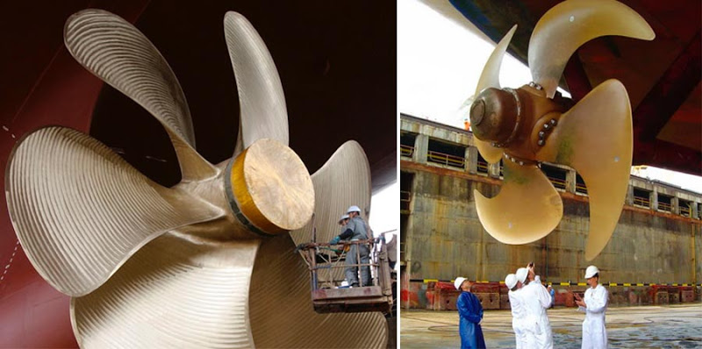
Historically field of expertise of “class”
Traditionally focused on asset physical properties, such as:
  strength of hull
  separate watertight compartments
  reliability of e.g. propellers
  hydro dynamics...

Slide 5
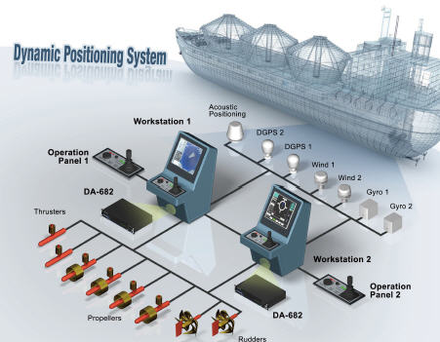

Safety more than physical strength and reliability
Software enables complexity
Latest step in the complexity “ladder”:
  Autonomous ships
How to create trust?
Trough evidence!

Slide 6

Human verification “agent”
Class surveyor (on-board verification)
  Knowledge:
    operational
    system
    testing
  Independence
Problem:
  Calendar-based (not condition-based)

Slide 7

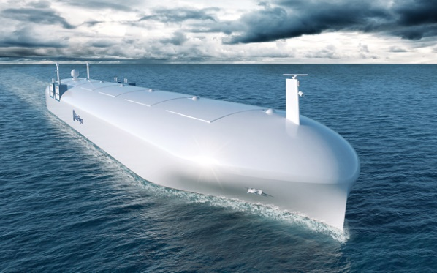
Evidence generated through (visual) inspection
Useful?

Slide 8
Evidence properties
type capability
instance capability/quality (correct, relevant, “complete”)
instance trustworthiness

Slide 9
Introducing algorithms into the verification effort

Slide 10
Why?
The “future” of the maritime and offshore assurance is condition-based
(Control) systems are complex and software-intensive
They might become online learning-enabled (changes behaviour during operation)
  E.g. autonomous navigation systems

Slide 11
Challenge
What happens to the assurance level if the verification is governed by (ML/AI) algorithms?
Are the algorithms somehow independent?
Are they objective?
If not, does it matter if they (seemingly) do the job?
Should we perhaps require that the algorithms are created independent from the system development?
What are they?
What are they doing?
Are their output (evidence) trustworthy?

Slide 12
Algorithm-based Verification Agent (AVA)
Examples:
  Generating Artificial Test Data through Automated Test Data Trajectory Generation Algorithm (ATTG)
  Generating Test Data Using Genetic Algorithms (GA)
  Online (safety) monitors
Notes:
Another example is the algorithms that calculates “pairs” in combinatorial testing.

Slide 13
What are they doing?
prioritize
rank
associate
classify
filter
governed by a design decisions made by developers
  criteria used for ranking
  taxonomy for classification
  rules for filtering
  degree of correlation between items

Slide 14
What are they doing? (cont.)
Algorithm-based Verification Agents (AVAs) generates, or are instrumental in the generation of evidence
They are agents:
  possessing a certain role with in the verification effort
  performing tasks
  holding certain responsibilities

Slide 15
Evidence trustworthiness

Slide 16
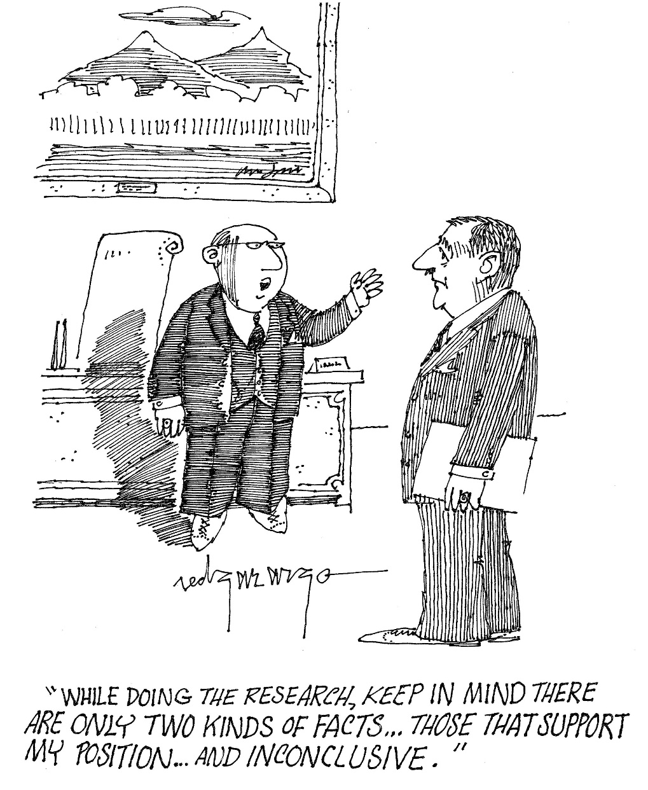
Enemies of trustworthiness in the evidences
Lack of objectivity
Infected by the same biases as in the development

Slide 17


Algorithm-generated evidence
“Accurate” picture of the "state of affairs“, or “bright skies” wherever you look?

Slide 18
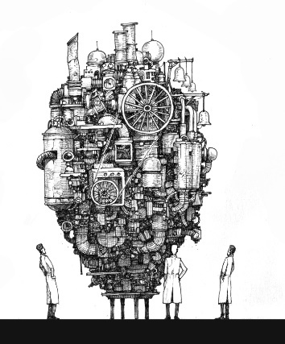
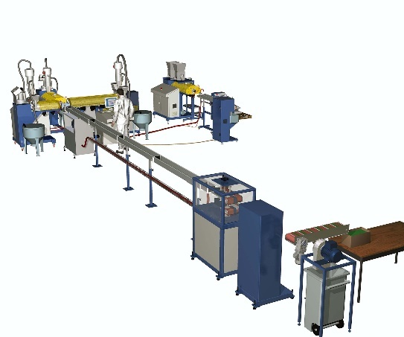


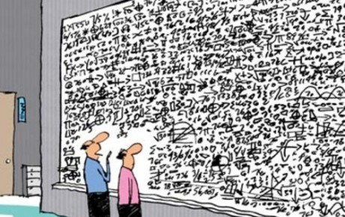


AVA
hmmm...
Trustworthy???
Human assessor

Slide 19

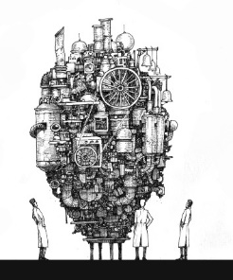





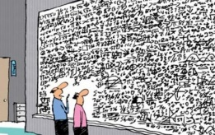
Human verifier
Trustworthy!
AVA
Human assessor

Slide 20
Emic and Etic (not Ethic)
borrowed from the social and behavioural science
Emic:
  an investigation and explanation by the viewpoint of the people within a culture or assemblage using their own perspective and concepts; an insider's viewpoint
Etic:
  investigating the behaviour of people or system from an outsider’s viewpoint using universal reference points

Slide 21
Emic and Etic AVAs
Etic-AVA: generates evidence based upon a different viewpoint from the developer of the target system
Emic-AVA: generates evidence based upon the same viewpoint as the developer of the target system

Slide 22


Etic AVA
Independent developer
Target system developer
AVA
Trustworthy!
Human verifier

Slide 23

Emic AVA
Target system developer
Etic Verification
Trustworthy(?)
AVA
Human assessor

Slide 24
Summary
In the maritime industry:
  The traditional assurance framework will change
  Algorithms will become instrumental in generating safety evidence
  These algorithms must somehow be assured so that the evidence generated are/have:
    adequate capability
    adequate quality
    Trustworthy and objective

Slide 25
Thank you
Odd Ivar Haugen
odd.ivar.haugen@dnvgl.com
+4791715040

