Slide 1


The future of the hub system
Gert Meijer
Aviation Academy
of the
Amsterdam University
of Applied Sciences
INAIR 2015
November 12/13
Holiday Inn Amsterdam

Slide 2
Introduction
■ Many airlines operate a hub-connected network
■ Many airports need transit passengers for volume
■ The number of long-haul city-pairs served non-stop is growing fast
■ How will this effect the structure of hub systems?

Slide 3
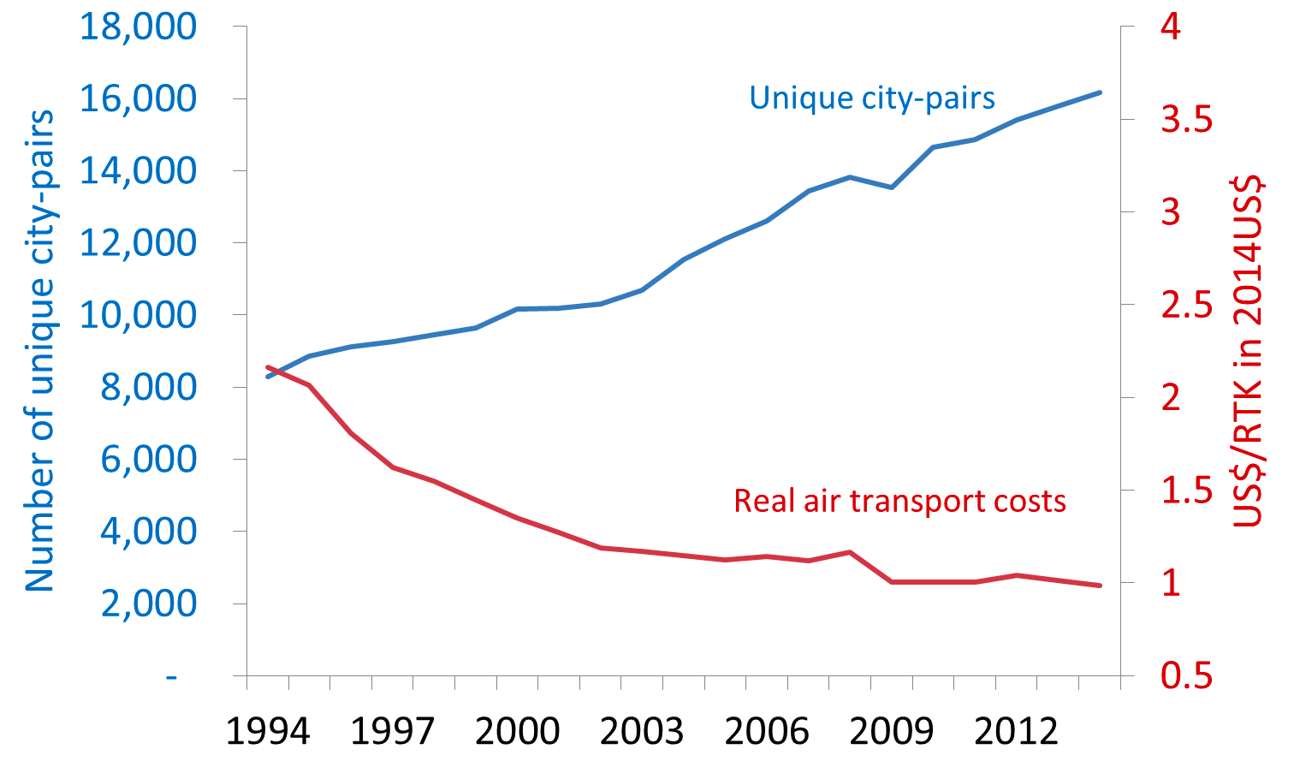
City-pair growth
source: IATA

Slide 4
Growth of the aviation industry
Regional/Global
Urbanisation
Growth of
city-pairs
served
non-stop
Growth of relevant airports
Population growth
Growth of demand for airline connections
Economic growth

Slide 5
The three fundaments of aviation
Technology
Economics
Politics
Growth of unique city-pair services enabled by technological, political and economic developments

Slide 6
Networks in the ‘70s of last century
Many airlines could not fill their large capacity long-haul aircraft on the basis of home-base demand only
Technology
Economics
Politics
Frequencies were moderate with long haul often <7 flights per week
International city-pair connections were limited to capital cities for protection of domestic/regional airlines
Hub systems were essential for all city-pair connectivity

Slide 7
Continental city-pair growth as from the ‘80s
Cost effective narrow body equipment with continental range
Technology
Economics
Politics
Markets demand for
short/medium haul city-pairs
Freedom to fly every city-pair within the deregulated area
Hub systems became less essential for continental connectivity

Slide 8
Long-haul city-pair growth
Long-haul twin-engined aircraft enable cost effective operations at moderate capacities
Technology
Economics
Politics
Markets demand for long-haul city-pairs
Multilateral liberalization between regions
Hub systems are changing in intercontinental city-pair connectivity

Slide 9
Long-haul city-pair growth pattern
■ from the hub to secondary destinations
SO = Secondary Origin
SD = Secondary Destination
SD
example: Cathay Pacific
Hongkong-Manchester
Hongkong-Dusseldorf
hub
SD
■ from secondary home stations to partner hubs
SO
example: Delta
Boston-Paris CDG
Raleigh Durham-Paris CDG
hub
SO

Slide 10
Traditional hub connectivity
SO = Secondary Origin
PD = Primary Destination
SD = Secondary Destination
non-stop connection
hub
PD
one-stop connection
SO
hub
PD
two-stop connection
SO
hub1
hub2
SD

Slide 11
Traditional hub connectivity: example
SO = Secondary Origin
PD = Primary Destination
SD = Secondary Destination
non-stop connection
hub
PD
Atlanta
Frankfurt
one-stop connection
SO
hub
PD
Mobile
Atlanta
Frankfurt
two-stop connection
SO
hub1
hub2
SD
Mobile
Atlanta
Amsterdam
Stuttgart

Slide 12
Emerging hub connectivity:
non-stop to secondary destinations
SO = Secondary Origin
PD = Primary Destination
SD = Secondary Destination
non-stop connection
hub
PD
one-stop connection
SO
hub
PD
two-stop connection
SO
hub1
hub2
SD

Slide 13
Emerging hub connectivity:
non-stop to secondary destinations
SO = Secondary Origin
PD = Primary Destination
SD = Secondary Destination
non-stop connection
hub
PD
Atlanta
Frankfurt
one-stop connection
SO
hub
PD
Mobile
Atlanta
Frankfurt
two-stop connection
SO
hub1
hub2
SD
Mobile
Atlanta
Amsterdam
Stuttgart

Slide 14
Emerging hub connectivity:
non-stop to secondary destinations
SO = Secondary Origin
PD = Primary Destination
SD = Secondary Destination
non-stop connection
hub
PD
Atlanta
Frankfurt
one-stop connection
SO
hub
PD
Mobile
Atlanta
Frankfurt
two-stop connection
SO
hub1
hub2
SD
Stuttgart
■ Declining reliance on two-hub connections

Slide 15
Emerging hub connectivity:
non-stop from secondary origins
SO = Secondary Origin
PD = Primary Destination
SD = Secondary Destination
non-stop connection
hub
PD
one-stop connection
SO
hub
PD
two-stop connection
SO
hub1
hub2
SD

Slide 16
Emerging hub connectivity:
non-stop from secondary origins
SO = Secondary Origin
PD = Primary Destination
SD = Secondary Destination
non-stop connection
hub
PD
Atlanta
Paris
one-stop connection
SO
hub
PD
Raleigh Durham
Atlanta
Paris
two-stop connection
SO
hub1
hub2
SD
Paris
Stuttgart
■ By-passing the home hub

Slide 17
Observations
■ Changing positions of hubs in alliance networks
■ Changing traffic flows in alliance networks
■ Long-haul city-pair developments primarily take place
within alliance networks
■ Long-haul city-pair development needs O+D AND hub potential
of the hub airport for route economics
■ Changing strategic airport/airline positions within alliances?
Airport capacity
consequences?

Slide 18
Topics for further analysis
■ Is this development a new phase in hub competition?
■ Can we quantify this development?
■ In total passenger numbers this development may not be significant yet,
the first shift is at the higher booking classes, is this visible yet?
■ Do US carriers dominate this development?

Slide 19
Final considerations
■ The non-stop/one-stop connections produces value for the higher
booking classes: high yield
■ The non-stop/one stop connection are produced against lower unit cost
■ Commercially attractive product, for the airline and for the passenger
■ Modus for airline growth at congested hubs
■ Emissions per passenger are lower for the
non-stop/one-stop connection
■ Development of non-stop long haul connections will continue

Slide 20
Questions?
INAIR 2015
November 12/13
Holiday Inn Amsterdam

