Slide 1
Trends in airport surface access in the London multi-airport system
Richard Moxon
Senior Lecturer, Air Transport Management Group, Cranfield University, UK
r.moxon@cranfield.ac.uk
November 13th 2015
Notes:
Since 2007 : Lecturer in Masters courses in ‘Airport Planning and Management’ (course director) and ‘Air Transport Management’ at Cranfield
Worked for former UK airport operator BAA at Heathrow and Gatwick from 1997-2006
Now working part-time to pursue PhD research in airport surface access

Slide 2
Aims and Objectives
To assess the impact of UK government airport surface access policy on the London multi-airport system :
- Examine government action since 1998
- Review of move from state ownership to competing private enterprises
- Quantify change in public transport use by employees and passengers at the airports
- Analysis of current surface access targets and how they have changed over time in nature and ambition
- Identify emerging issues as raised by the airports

Slide 3
Methodology
Literature review : multi-airport systems, airport surface access strategies, airport surface access environmental impact, UK government publications
6 London system airports considered : Heathrow, Gatwick, Stansted, Luton, City and Southend
Semi-structured interviews with senior planning and operational managers at each airport in 2014
Analysis of passenger and staff surface access data provided.
Highlight successes, failures, innovations and potential trends in passenger and staff airport surface access management

Slide 4
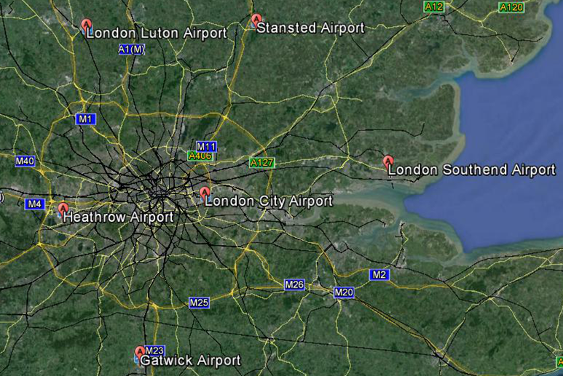
The London multi-airport system
Annual passengers/% transferring
10M/2%
20M/5%
1M/<1%
4M/2%
73M/36%
38M/8%
Source : Google, UK CAA (2015), Southend Airport

Slide 5
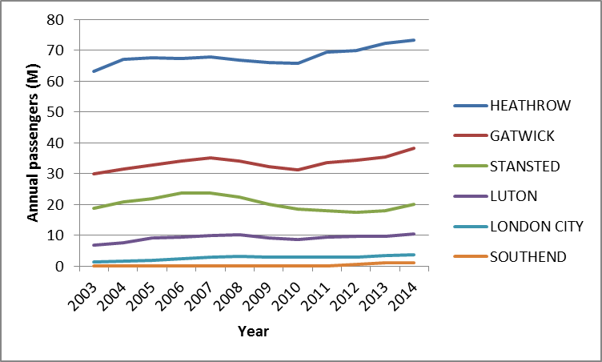
The London multi-airport system 2003-2014
Primary airports
Most volatile
Secondary airport
market
specialisation
Most resilient
Source : UK CAA (2015)

Slide 6
Hierarchy of preferred surface access modes – Airport Management Perspective
Car parking
Taxi
Drop-off / pick-up
Public transport
transport
More environmentally sustainable
Return air trip =
2 private vehicle
journeys
Return air trip =
4 private vehicle
journeys
Less environmentally sustainable
Source : Ryley et al, 2013
Notes:
Interviews with 14 airport transport managers in UK airports

Slide 7
1. Key airport planning related United Kingdom government documents impacting London airports 1998-2006
‘A new deal for transport: better for everyone’ White Paper, 1998
‘Guidance on airport transport forums and airport surface access strategies’ Guidance, 1999
‘Airport transport forums good practice guide’ Guidance, 2000
‘The future of air transport’ White Paper, 2003
‘Guidance on the preparation of masterplans’ Guidance 2004
‘Air transport white paper progress report’ Report 2006
Encouraging shift from private to public transport

Slide 8
1. Key airport planning related United Kingdom government documents impacting London airports 2006-2013
‘The Stern review’* Report, 2006
‘The Eddington transport study’ Report, 2006
‘The Airports Act’* Law, 2006
‘The Civil Aviation Act’* Law, 2012
‘Airports Commission: Interim report’ Report, 2013
‘Aviation policy framework’ White Paper, 2013
More sporadic reference to surface access :
* = no mention

Slide 9
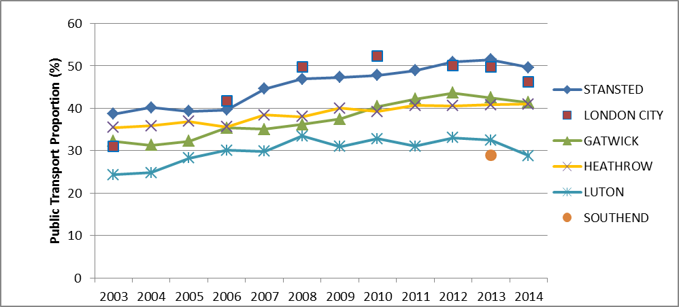
Passenger Public Transport Surface Access Modal Share 2003-2014
Most successful
No decline
Source : UK CAA, Airports (2015)
What’s
happening?

Slide 10
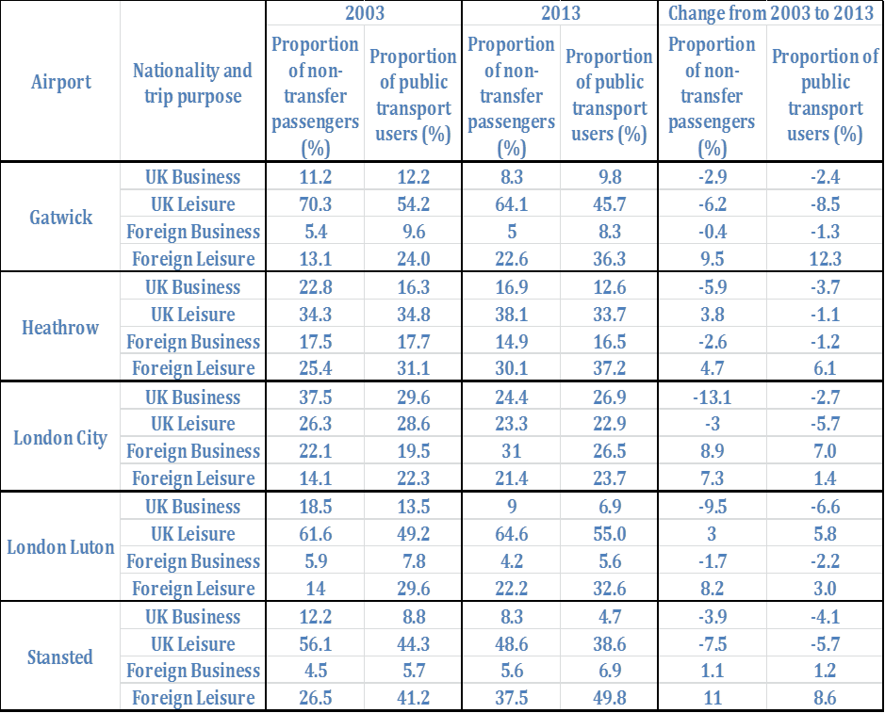
Drivers of shift to public transport 2003-2013 :
Heathrow, Gatwick and Stansted : Foreign leisure pax
London City : Foreign business pax
London Luton : UK leisure pax
Market segmentation by nationality and trip purpose

Slide 11
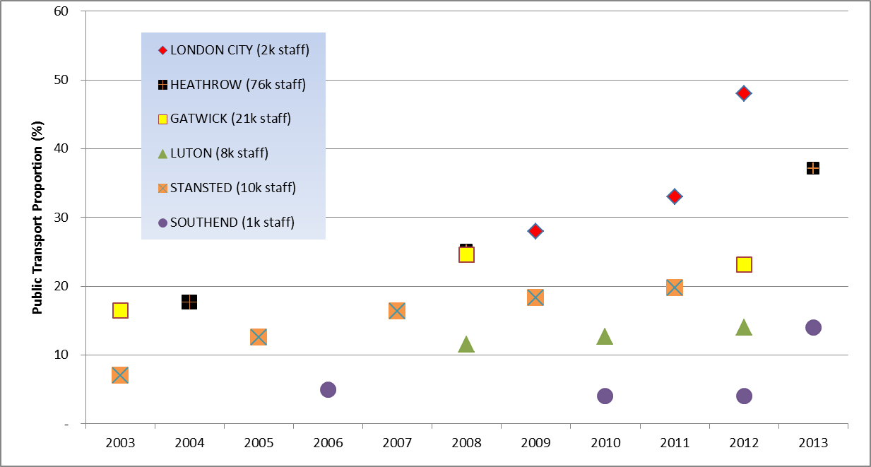
Staff Public Transport Surface Access Modal Share 2003-2013
All going up,
except LGW
2014?
Source : Airports (2014)

Slide 12
Surface Access Strategy targets - passengers
 | 2003 | 2014
LONDON CITY | Encourage more local bus services to divert into LCA | 70% public transport by 2023
GATWICK | 40% public transport by 2008 | 40% public transport by 40 mppa*
HEATHROW | 40% public transport by end of 2007 | > 40% public transport by 2019
LONDON LUTON | 30% public transport (no target year) | 40% public transport by 2017
STANSTED | 25% public transport by 2005 | 43% public transport by 35 mppa*
LONDON SOUTHEND | No specific target | > or = 20% public transport by 1.5 mppa* and 25% by 2mppa*
* mppa = millions of passengers per annum

Slide 13
Surface Access Strategy targets – staff
 | 2003 | 2014
LONDON CITY | Encourage more local bus services to divert into LCA | 40% single occupancy private vehicle by 2023
GATWICK | 12% of staff living in Crawley/Horley use local bus. Double staff cycling by 2008 | 40% public transport by 40 mppa*
HEATHROW | 2.6% staff cycling by 2003. 2000 car sharers with 65% actively sharing by 2003 | < 45% single occupancy private vehicle by 2019
LONDON LUTON | 6% public transport (no target year) | < or = 60% single occupancy private vehicle by 2017
STANSTED | 88% arrive as car drivers by 2003. 25% arrive as car passengers by 2004. Double cycling by end of 2003 | < or = 70% single occupancy private vehicle by 35 mppa*
LONDON SOUTHEND | No specific target | Sustain < or = 65% staff single occupancy vehicle
New focus on single occupancy vehicles

Slide 14
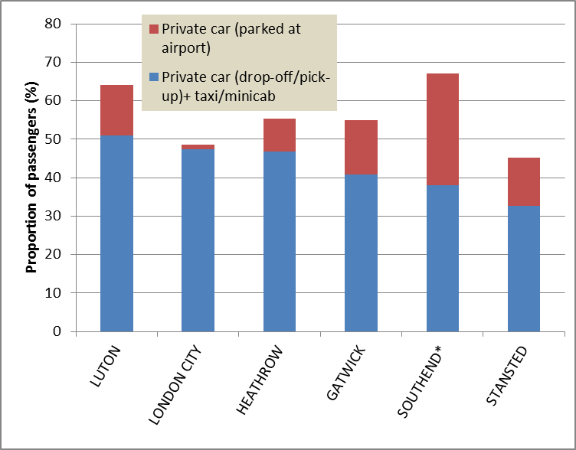
Passenger modal split 2012*/2013
Source : UK CAA, Southend Airport* (2014)

Slide 15
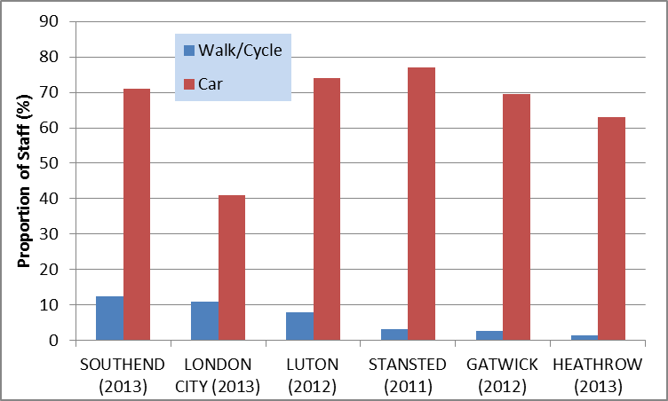
Staff modal split
Big focus
Smaller airports close to city centres
= more resilience in bad weather
and emergencies
Source : Airports (2014)

Slide 16
Potential trends and issues
Further consideration of charging users to drop off passengers at airports
Investigation of methods to discourage empty taxi journeys to or from the airport
Increased pressure on public transport operators to provide early and late services for operational staff
More ambitious targets for staff and passenger airport access as conditions of planning approval
Further recognition of environmental (as well as commercial) advantages of passenger parking

Slide 17
Trends in airport surface access in the London multi-airport system
Richard Moxon
Senior Lecturer, Air Transport Management Group, Cranfield University, UK
r.moxon@cranfield.ac.uk
November 13th 2015
Notes:
Since 2007 : Lecturer in Masters courses in ‘Airport Planning and Management’ (course director) and ‘Air Transport Management’ at Cranfield
Worked for former UK airport operator BAA at Heathrow and Gatwick from 1997-2006
Now working part-time to pursue PhD research in airport surface access

