Slide 1




Aircraft Lateral Flight Optimization Using Artificial Bees Colony
Alejandro Murrieta-Mendoza, Audric Bunel, Ruxandra M. Botez
Université du Québec / ÉTS/ LARCASE

Slide 2
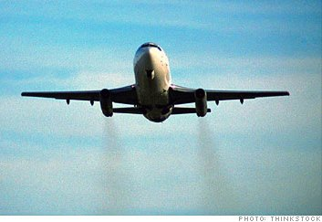

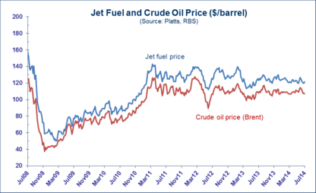
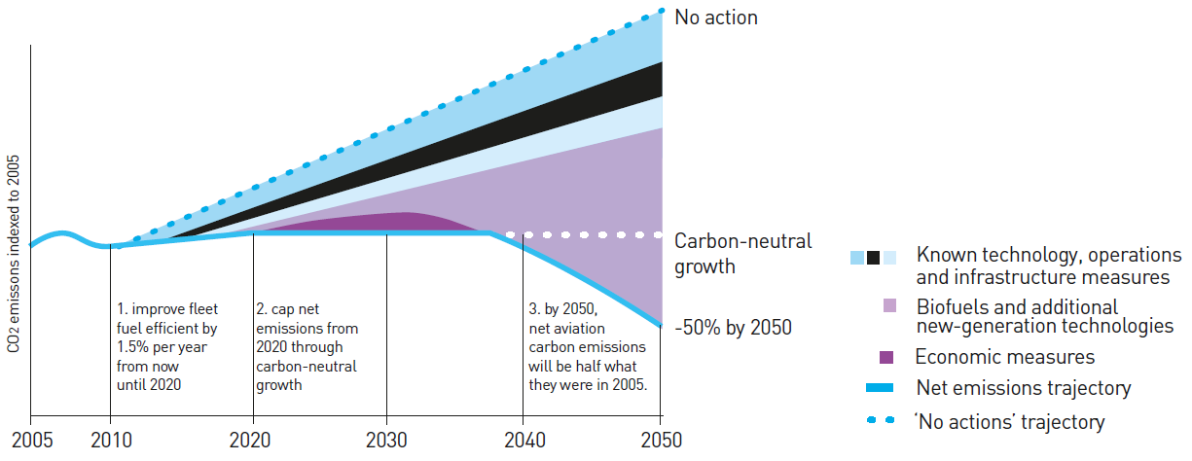
Motivation
www.ucalgary.ca
Aeronautical Industry CO₂ production:
2%
Airline Expenses: 26%

Slide 3
Motivation
Canada:
The Green Aviation Research & Development Network (GARDN)
      Develop technologies to reduce aircraft noise and emissions.
        Governmental Funding + Industrial Funding + University Expertise

Slide 4
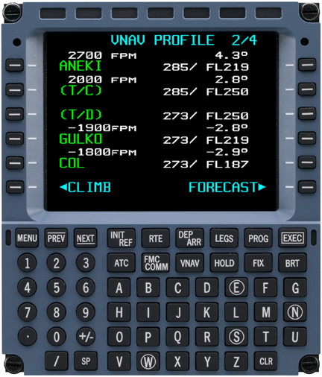
Introduction
Two types of reference trajectory
  1.-Typical Vertical Navigation:
VNAV

Slide 5
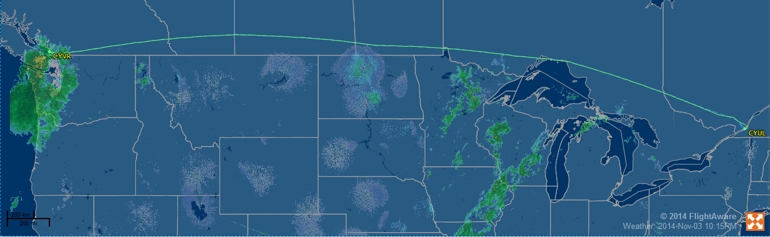
Introduction
      2.- Lateral Reference Navigation (LNAV)

Slide 6
Objectives
    Find the combinations of waypoints that reduce the fuel requirements .
    Reduce emissions caused by fuel burn.
    Reduce the flight cost
    Explore the Artificial Bees Colony Algorithm Potential

Slide 7
Trajectory Studied
Cruise Phase
  Montreal - Paris
Constant Altitude
Fixed Mach number

Slide 8

Methodology
Flight Cost
$$Cost=Fuel_Burned + Cost_Index ∗ Flight_Time$$
$$f(weight, speed, altitude, temperature,traveled distance)$$
$$f(traveled distance, speed)$$

Slide 9
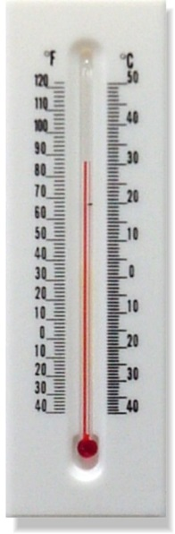
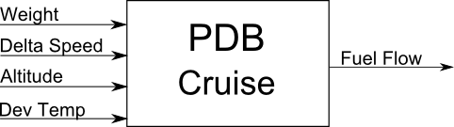
Methodology
Performance Database
Flight Mode | Inputs | Output
Cruise | Mach Gross weight (kg) ISA deviation temperature (C) Altitude (ft) | Fuel flow (kg/hr)
$$ISA_DEV_T=TMP−ISA_Temperature$$

Slide 10
Methodology
Ant Algorithm
  Ants wander around for food sources.
  Different ants find the same food source.
  Over time the shortest path is selected.
  Use pheromone to keep track of the path
    The more ants are in a path, the more pheromone there is

Slide 11
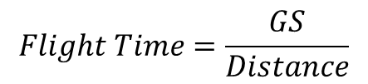
Methodology
Flight time
  Flight Speed
$$Flight Time=\frac{GS}{Distance}$$
$$GS=TAS ± Wind_Speed∗ \cos{(Wind_Angle)}$$

Slide 12
Methodology

Slide 13
Methodology
Bees!
  Working Bees: Exploit known food sources.
  Onlooker Bees: Exploit the best food sources.
  Scout Bees: Look for new food sources.
  Food Source = A given trajectory

Slide 14
Methodology
Step 1: Initialization
  Generate Random Trajectories.
  Assign Every Trajectory to a Different Working Bee.
Step 2: “Working Bees”
  Mutate the given trajectory
    Random waypoint is selected and its trajectory is changed.
    Better trajectory found? Replace the old one.
    Mutation failed? Keep count!

Slide 15
Methodology
Step 3: On-looker bee.
  Every Trajectory is Rated by its Fitness.
  The most promising trajectories are selected.
  The selected trajectories are mutated as the working bees do.
Step 4: Scout Bee
  Maximal counting number: Discard the trajectory
    It is the optimal!! – Doesn`t matter it is already stored.
  Create a new one. Assign it to a working bee

Slide 16
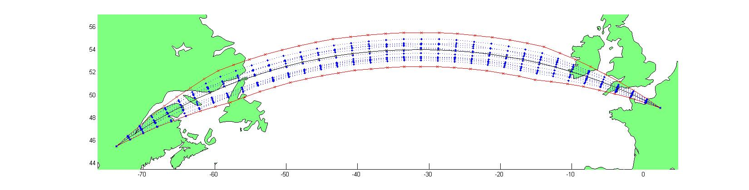
Methodology
Step 5: When do we stop?
  Maximal number of iterations.

Slide 17
Results
Montreal to Paris
  2970 nm
  36 waypoints
  Mach number constant
  Fixed flight level.

Slide 18
Results
Trajectories
  Green: Optimal Candidates
  Black: Reference
  Blue: Limits
  Red: Optimal

Slide 19
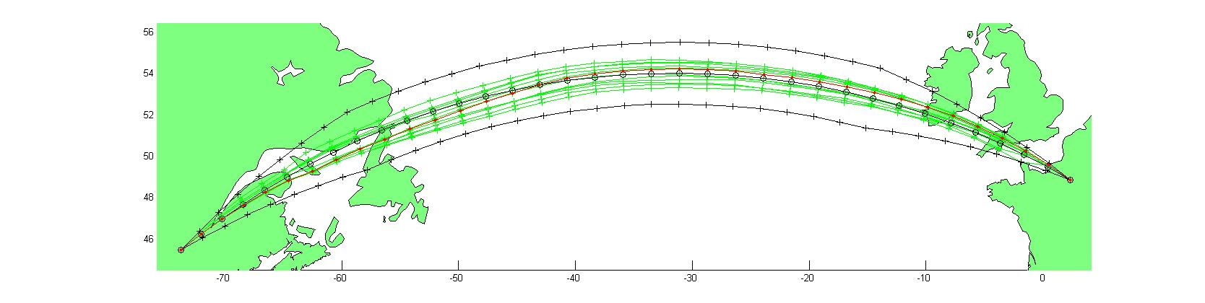
Results

Slide 20
Results
Fuel burn savings:
  102 kg – 140kg

Slide 21
Conclusion
The ABC algorithm was able to find better routes than the reference.
Flight cost was reduced.
Reduction depends on weather
More flights are required to measure the real impact.

Slide 22
Thank You
Q & A

