Slide 1
What about the
Flag System?
Amsterdam, 22 juni 2018

Slide 2
Start of the Flag System
Training in different settings: schools, institutions, child care…
In 2008
  A lot of cases of unacceptable sexual behavior: for who?
  No proper pedagogical approach
  Reactive to incidents, no prevention or policy
  Discussions on grey area
  Pressure and lack of confidence tw school & institutions
  Different opinions

Slide 3
Start of the Flag system
Developmental Chart: what is part of “normal” sexual development
How can we help professionals and parents to integrate proper guidance on sexuality in their pedagogical work
  We need criteria to make objective assesements
  How can we stimulate communication
  How can we help to nuancate and distinguish between severe SA and “normal” behavior

Slide 4
What is causing harm?
Sort of sexual behavior: duration, frequention, Level of intimicy
Individual factors: Young age
Experience: level of anxiety
Social factors: Level of coërsion used, Relationship with perpetrator
Context factors: When a child cannot get away, Level of secrecy, Level of support afterwards

Slide 5
An example:
Boys of 13 show their penis to playing children. For them it’s a joke, for the children not so
What are the questions?

Slide 6
Considerations
What do other children do at age of 13
Is this harmful for the little children involved?
Is there pressure involved?
Why am I not certain?
What do I feel?
What will my teammates think?
What will parents want us to do?
What do we want children to learn?
How to respond?

Slide 7
Needs
I need
  An objective measure to hold my judgement against
  A system facilitating deliberation and communication with all partners involved
  A consistent response to teach children appropriate sexual behavior
  A method for critical reflection on the policy of my organisation tw sexuality

Slide 8
The Flag system, how does it work?
Steering wheel & 6 criteria
Consent
Voluntary engagement
Equality
Appropiate for age and/or development
Appropriate for context
Self-respect

Slide 9
Example:
Consent?
Voluntary engagement ?
Equality?
Development ?
Context?
Self-respect ?

Slide 10
Continuum of flags
Green flag: acceptable and not harmful sexual behavior
Yellow flag: occasional light Sexual Abusive Behavior
Red flag: troubling SAB
Black flag: severe SAB

Slide 11
No green flag, what else?
criteria | yellow | red | black
Consent | No clear NO | Clear NO | Repeated clear NO
Voluntary engagement | Light coersion | Coersion, violence & blackmail | Severe coersion, violence & blackmail
Equality | Light inequality | Bigger inequality | No equality
Development | Development +/- OK | Development - OK | Development - OK
Context | Context +/- OK Lack of privacy | Context – OK No privacy | Context – OK No privacy
Self respect | Little risk | Severe risks | Severe risks

Slide 12
Extra indicators
More or less severe if there is
 | yellow | Red | black
Level of intimate touch | verbal | touching | Intimate touching
Level of anxiety or distress shown | Little anxiety or distress | Some serious anxiety or distress | Serious anxiety or distress
Repeated behavior | On only one occasion | On repeated occasions | On repeated occasions
Awareness |  |  | Awareness of harm

Slide 13
Example: Yellow Flag
Consent
Voluntary engagement
Equality
Development
Context
Self-respect
extra
No touch
No anxiety
No repetition

Slide 14
Same judgement if..
Boys are autistic or disabled?
Boys have been victimised?
Boys have foreign origine?
Boys are girls?
Understanding?
Role reversal as offenders?
Other norms and values?
Potential victim?

Slide 15
Disharmonic development profile
If biological development is not keeping pace with
  Psychological development
  Social development
Focus on emotional development and underlying needs
  Sometimes by more and better protection
  Sometimes by more time and repetition
  Always by adressing the child at his/her emotional level

Slide 16
Development Chart
Results from scientific research
Indication of “normal” sexual development
Age categories
Examples of green, yellow, red and black
! Situations=
  looking more closely for underlying problems
  Could be a signal of sexual abuse
  Context is the problem, not the person

Slide 17
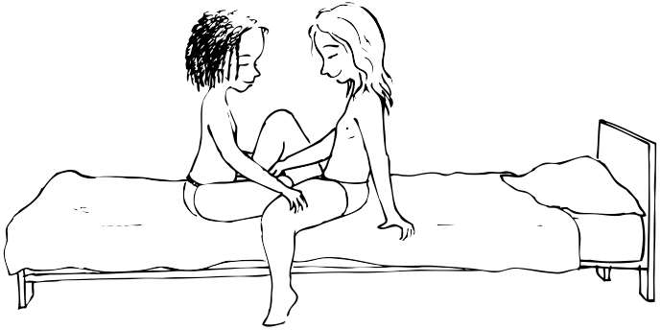
Example:
Two girls of 13 sit on the bed in the bedroom. They caress each other between the legs and they like it.
Notes:
En deze? Is wellicht al wat moeilijker te beoordelen.

Slide 18
Green Flag!
Two girls of 13 sit on the bed in the bedroom. They caress each other between the legs and they like it.
Consent
Voluntary engagement
Equality
Development
Context
Self-respect
Notes:
En deze? Is wellicht al wat moeilijker te beoordelen.

Slide 19
!
Means
  The context is the problem
  More care for the children involved
  Possible signal of abuse
  Looking at underlying problems

Slide 20
Green flag
Normal part of development
! How influencing the context:
  Room for experimenting: where and when?
  How meanwhile protecting from doing harm
  How make rules and reguations?
  How to organise as a team
  How to explain to parents

Slide 21
How to respond?
Towards the children
  Educational approach: explaining, coaching, supervision and boundaries
Towards parents
  Information, partnership, cooperation
Towards team
  Team discussions and agreements
Towards organisation
  General policy on sexual health

Slide 22
Pedagogical response short term
 | green | yellow | red | black
Facts | Describe | v | v | v
Feelings | How do we feel? | v | v | v
Information: what is oké | What is oké and why | v | v | v
Information: what is not oké |  | What is not oke and why | v | v
Information: consequences |  |  | Effect | Effect
Agreements & monitoring |  |  | What do we agree | How to monitor
Reporting |  |  | Report | Report

Slide 23
Response short term
Towards the boys:
  Facts:You have been playing a game and showed your penis to very young children
  Feelings: How do you feel about that? Did the children like it? I am worried
  What is OK: It’s sometimes OK to play that game with children your own age in a private setting
  What is not OK: but you don’t show your penis to young children in a public place, you could offend or frighten them
  Making agreements: can we make some agreements about this?

Slide 24
Pedagogical strategies long term
Green | yellow | Red | Black
Information Empathy & consience Psychological education
 | Cognitive coping Rewards Coaching
 |  | Time-out Supervision Restorative interventions Care
 |  |  | Punishment Measures Help Aftercare

Slide 25
What is the intended outcome of the Flagsystem?
The professional feels competent to condone healthy sexual behavior and prevent sexual abusive behavior
  Being able to understand and judge the sexual behavior
  Being able to discuss sexual behavior with all partners involved
  Being able to give an appropriate & consistent pedagogical answer

Slide 26
More levels
The target group is sexually resourcefull
  Knowing when sexual behavior is OK or not
  Being able to communicate about sexuality and boundaries
  Being able to respond appropriate to sexual abusive behavior
The management level
  Has a vision on sexual health
  Takes sustainable measures to protect sexual health and prevent sexual abuse
  Evaluates and rectifies

Slide 27
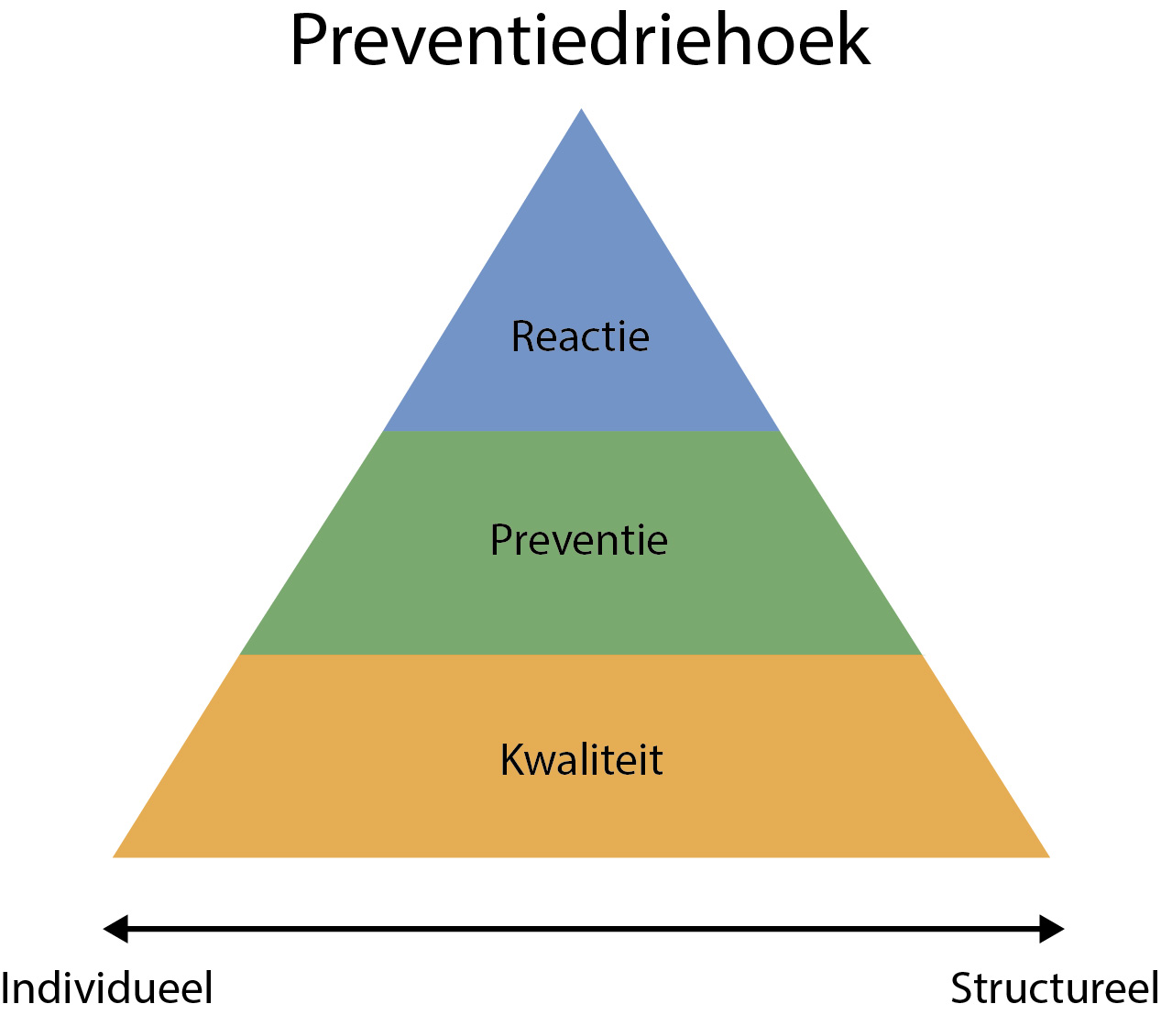
3 levels of influence: prevention triangle

Slide 28
Tools and materials
150 situations
2 Manuals
Development Chart
Steering wheel poster
Response guidelines
Protocol
Observation checklist
Training manual
Toolbox

Slide 29
Protocol
 | Green | yellow | Red | Black
Fase 1 | Assess situation Is situation acute?
Fase 2 | Internal deliberation external advise when needed |  | Internal deliberation Involving parents External advise
Fase 3 |  | Internal treatment | External treatment & counseling | External treatment & counseling Police/justice
Fase 4 |  | Internal evaluation | Internal & external evaluation Report Aftercare

Slide 30
What works?
Positive evaluations
Significant differences users and non users
  More self-confidence
  Improved correct judgement
  More knowledge of criteria
  Better pedagogical response
  Facilitating communication
  Effect on organisational policy

Slide 31
More evaluation
Terminology and theory is widely used within teams who had a training
Professionals have more information on sexual development, the effects of trauma and the causes of sexual abuse
Professionals feel more confident in judging & communicating and reacting
More personel effectivity and attitude change (= considering sexual behavior as part of a normal development)
Rules institution more tolerant tw green sexuality

Slide 32
What else
Need for more materials for talking to children, young people and parents
Special needs groups
  Methods for children with disability
  Situation for children in asylum
  Children with autism
In schools: lesson plans
In 2019: Flag System for adults

Slide 33
International implementation
Rutgers takes the lead
  Website Flagsystem.org
  Translation of the book
  Creating partnerships for implementation within countries
  Support by training, materials and advice

Slide 34
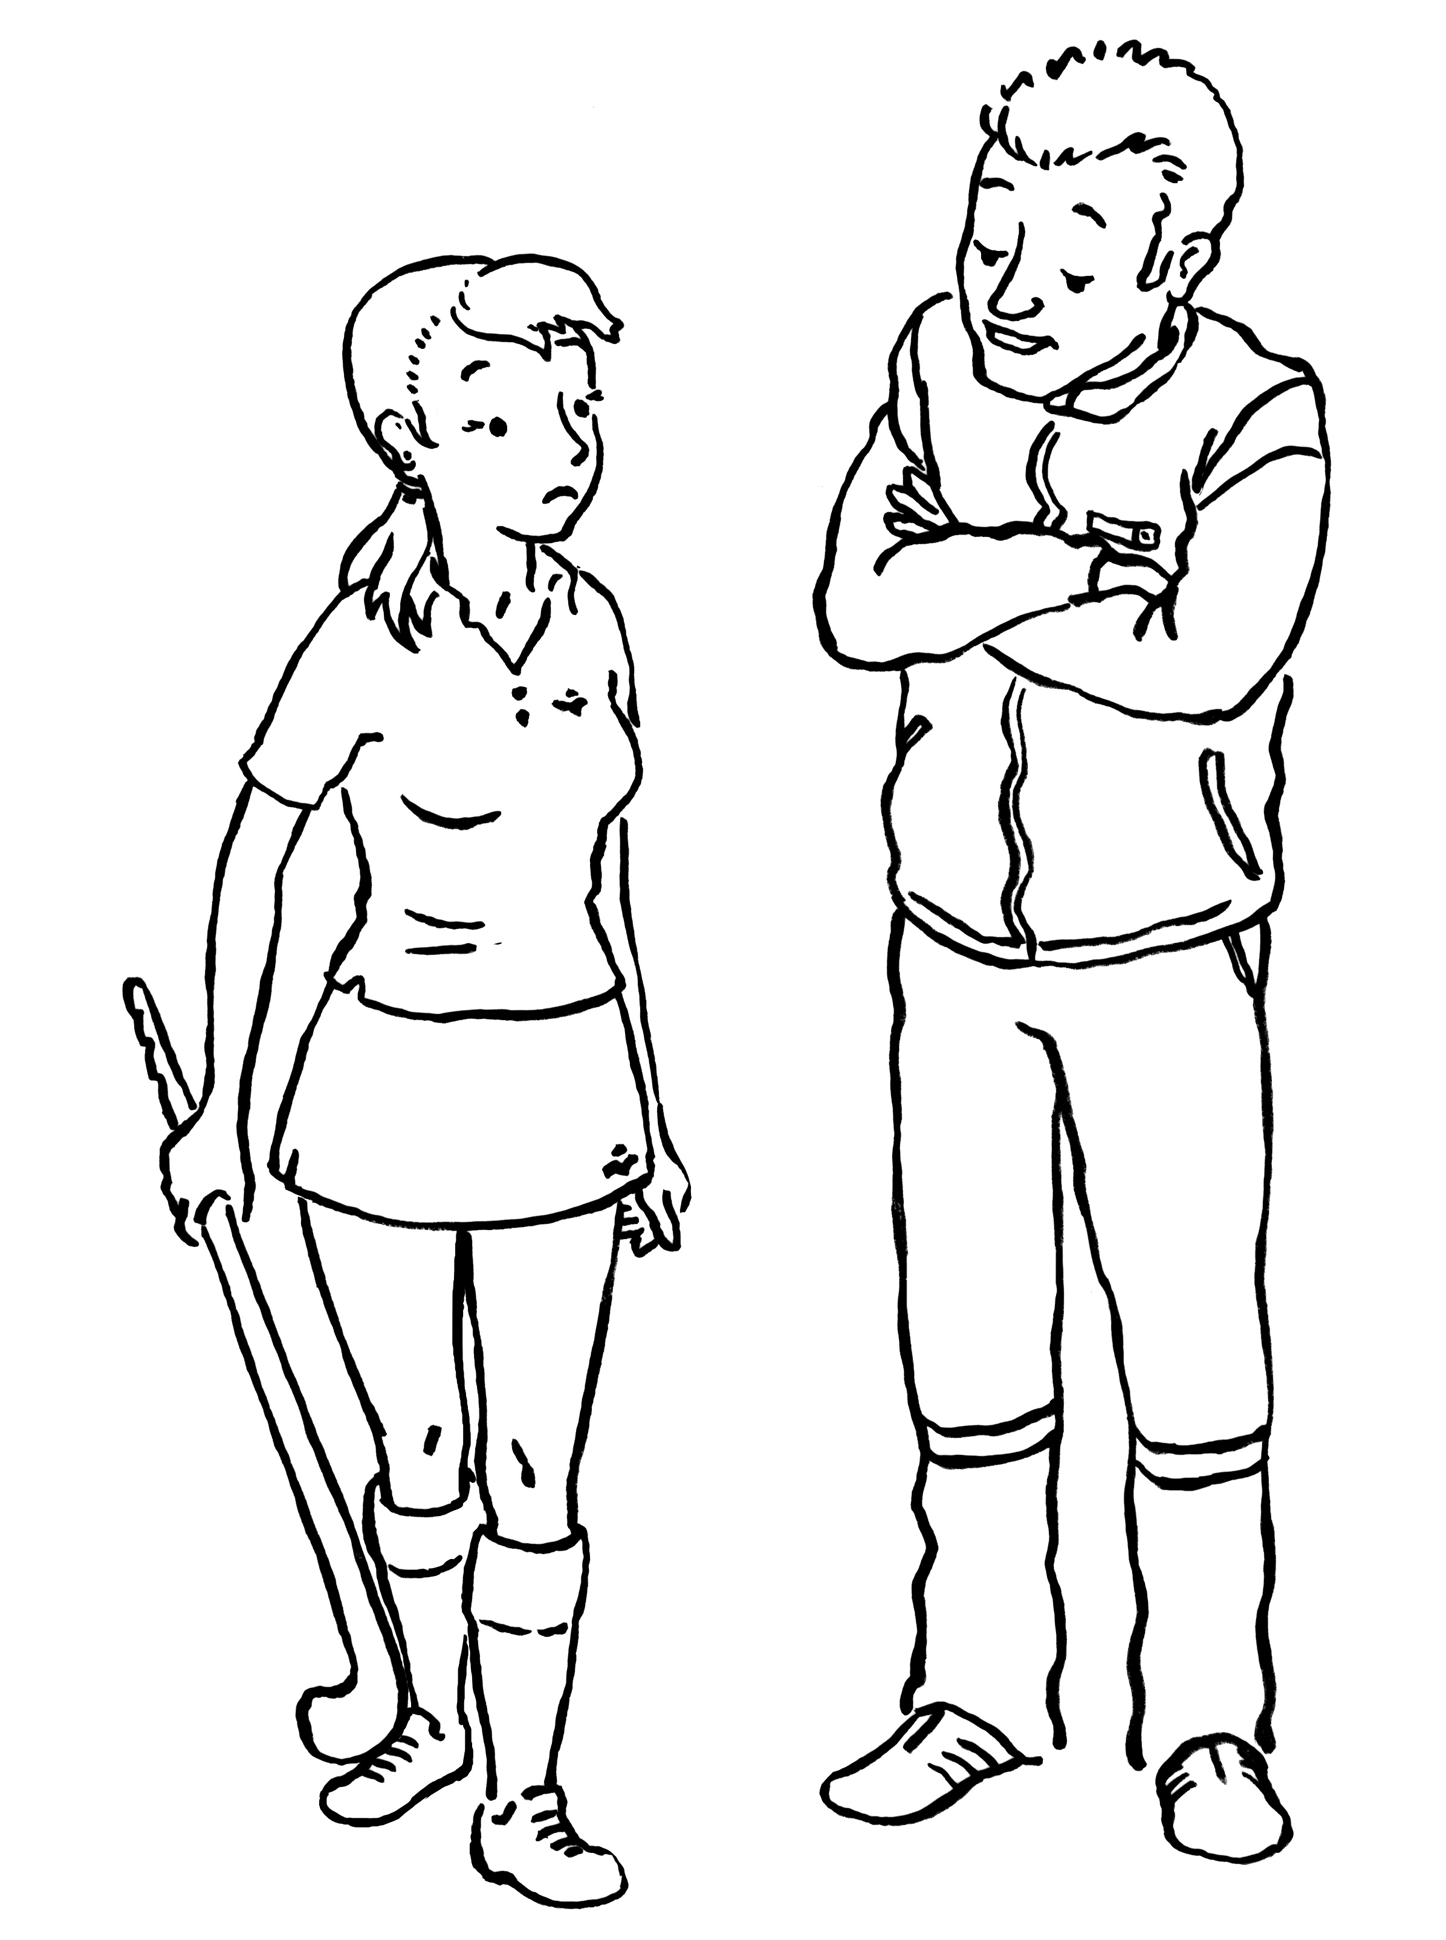
Good luck
Nice breasts!

